Slide 1

SIZZL
Mia Angwin, Isaac Kerstetter,
Harper Staton-Todaro, Corey Cunningham

Slide 2
AGENDA
INDUSTRY INSIGHTS
COMPANY INSIGHTS
CULTURAL CONTEXT
1
DISCOVERY
THE CHALLENGE
TARGET AUDIENCE
COMPETITIVE LANDSCAPE
RECOMMENDED STRATEGIES AND CREATIVES
STRATEGY
& CREATIVES
2
3
3
CONCLUSION

Slide 3
DISCOVERY

Slide 4
INDUSTRY ANALYSIS

Slide 5
“COOKING VIDEOS HAVE NEVER BEEN MORE PERSUASIVE, MORE INESCAPABLE, MORE ADDICTIVE, MORE ENTERTAINING. AND THEY’VE NEVER BEEN A MORE POWERFUL DRIVER OF POPULAR CULTURE.”
- Priya Krishna, The New York Times
https://www.nytimes.com/interactive/2023/08/07/dining/cooking-videos-tiktok.html

Slide 6
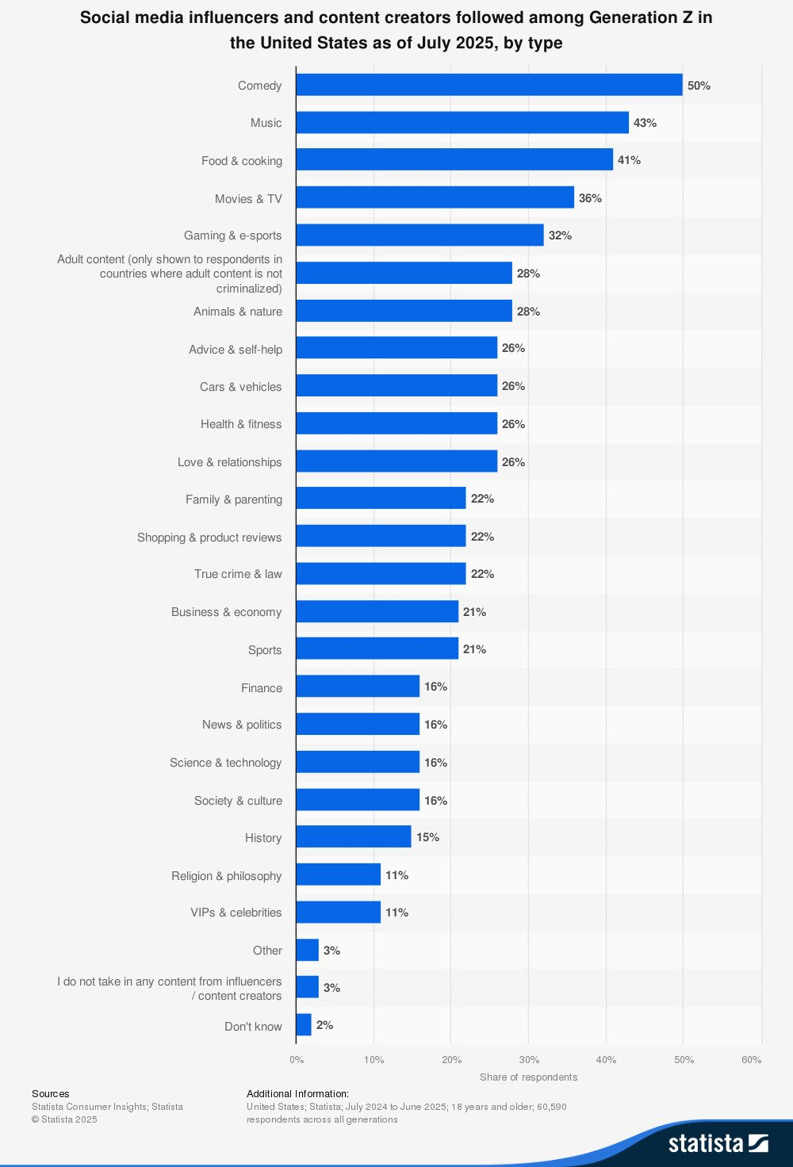
SOCIAL MEDIA INDUSTRY
MARKET SIZE:
63.9% of the world population uses social media
USD 208.08 billion in 2025
CONSUMER TRENDS:
Short-form video content
75% of global video is viewed on mobile
92% of mobile videos are shared with others
https://datareportal.com/reports/digital-2025-global-overview-report?utm
https://www.researchandmarkets.com/reports/5781298/social-media-market-report?srsltid=AfmBOooEmydPVBwGOrHWlDsfek9_jOY8QKzkiho1Mneb-noe6y0eHKr9&utm_
https://www-statista-com.lib-proxy01.skidmore.edu/forecasts/1490425/us-gen-z-influencers-content-creators-followed-by-type
Notes:
https://datareportal.com/reports/digital-2025-global-overview-report?utm
https://www.researchandmarkets.com/reports/5781298/social-media-market-report?srsltid=AfmBOooEmydPVBwGOrHWlDsfek9_jOY8QKzkiho1Mneb-noe6y0eHKr9&utm_
https://www-statista-com.lib-proxy01.skidmore.edu/forecasts/1490425/us-gen-z-influencers-content-creators-followed-by-type

Slide 7
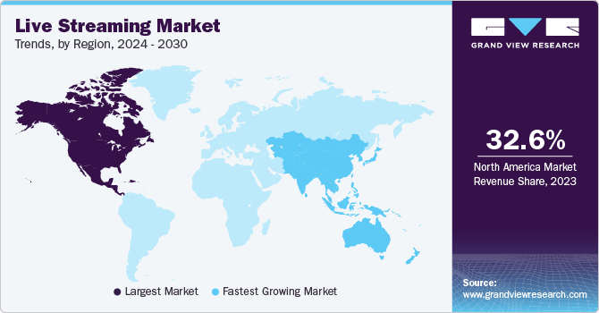
LIVE STREAMING INDUSTRY
MARKET SIZE:
USD 87.8 billion in 2024
CAGR ~23.9% by 2033
CONSUMER TRENDS:
Expect real-time, unscripted content
18 to 34-year-olds are the most frequent viewers
25.4 minutes per live session
https://bloggingwizard.com/live-streaming-statistics/?utm_
https://www.grandviewresearch.com/industry-analysis/live-streaming-market-report
Notes:
Takeaway: Live streaming is not a niche — it is a rapidly expanding segment, often with higher growth rates than broader video streaming.
https://bloggingwizard.com/live-streaming-statistics/?utm_
https://www.grandviewresearch.com/industry-analysis/live-streaming-market-report

Slide 8
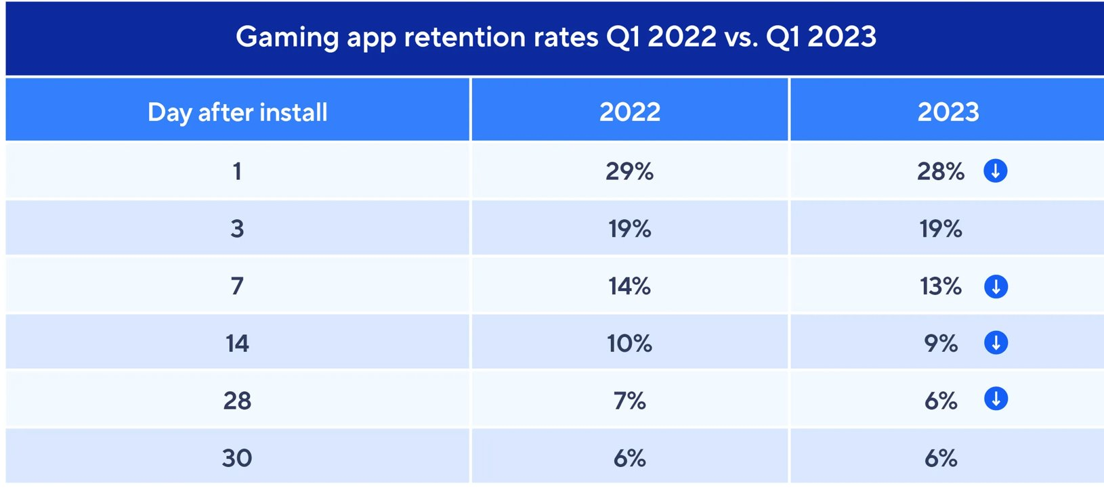
GAMIFIED APP INDUSTRY
MARKET SIZE:
USD 29.11 billion in 2025
CAGR of 26.02% by 2033
CONSUMER TRENDS:
Desire social and progression mechanics (leaderboards, status, collaboration)
Daily streaks motivate usage continuity
https://www.adjust.com/blog/the-latest-statistics-on-mobile-gaming-apps-2023/?utm
https://straitsresearch.com/report/game-applications-market?utm
Notes:
Takeaway: The gamified app industry is large and rapidly expanding, often forecasted with double-digit annual growth in the 20–30% range.
https://www.adjust.com/blog/the-latest-statistics-on-mobile-gaming-apps-2023/?utm
https://straitsresearch.com/report/game-applications-market?utm

Slide 9
COMPANY INSIGHTS

Slide 10
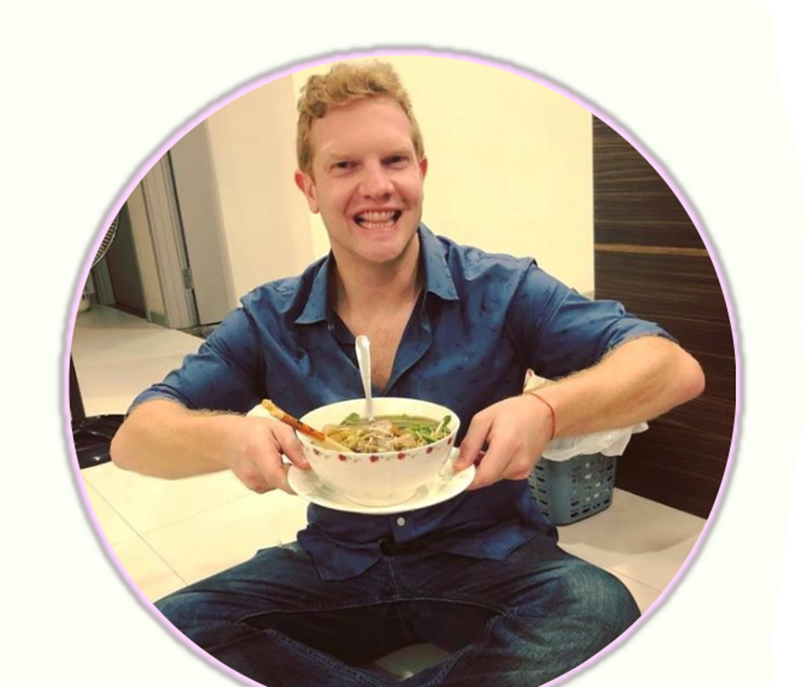

SIZZL ORIGINS
Founder & CEO Norman Harrower
  Led Emmy-nominated app Dead Yourself (14 million + downloads)
  Co-Founded previous start up in FitTeach (Raised over $1.5 Million)
    Launched 3 locations
COO & Head of Content Gina Hughes
  Formerly SVP, Marketing AMC Networks
  Awarded Hollywood Reporter's Key Art Award

Slide 11
KEY FACTORS
Trendspotting
Innovation
Engagement
Reinventing cooking for modern creators​
Connecting food lovers through play
Spotting tomorrow's flavours today​
​

Slide 12
CULTURAL CONTEXT

Slide 13
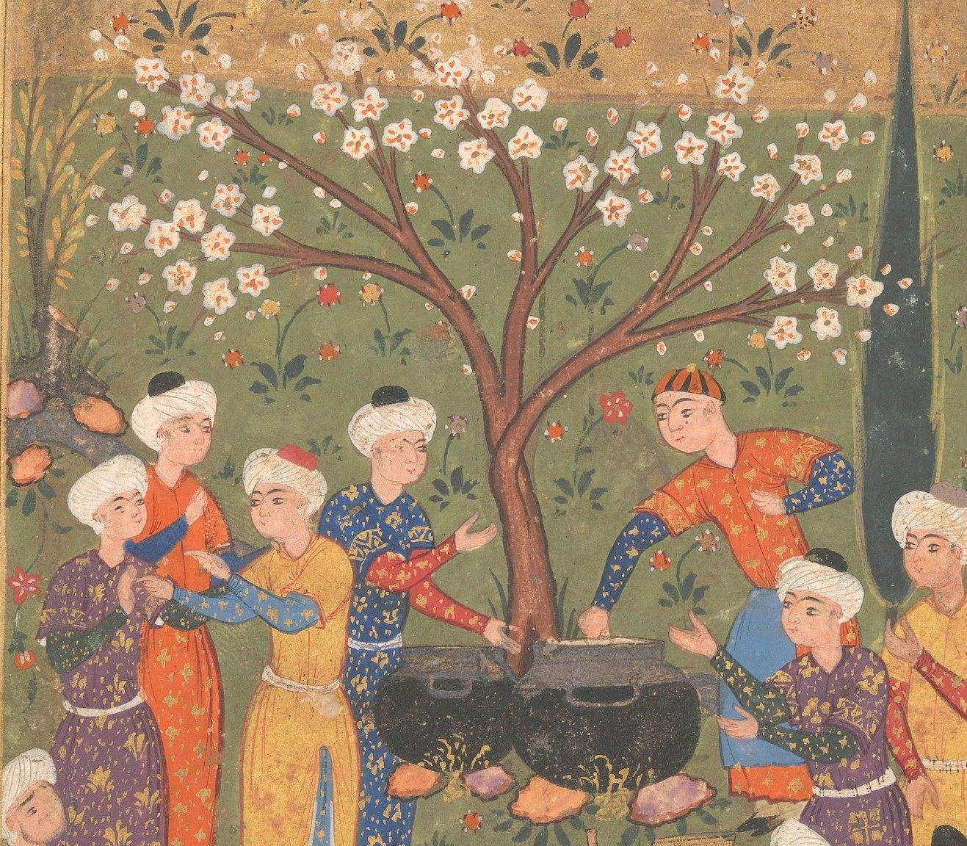
HISTORY
First cooking competitions: ninth century Baghdad!
In 1993, Iron Chef premiered in Japan
Now, 46% of US viewers have watched cooking competition show on TV in the last 30 days
Food has long been fascinating, exciting, and gamified.
https://www.salon.com/2022/07/13/when-cooking-became-cut-throat-a-brief-history-of-the-culinary-competition/
https://www.atlasobscura.com/articles/history-of-cooking-competitions
Notes:
Add picture of ninth century Baghdad

Slide 14
CURRENT TRENDS
Intrinsic and extrinsic motivations are positively associated with user participation on gamified apps
Achievement and social gamification satisfied competence, autonomy and relatedness needs
Game features that cater to users’ self-determination and motivation have higher retention and participation.
https://www.emerald.com/ijcs/article/1/1/71/129806/Motivation-mechanism-of-gamification-in
https://dlnext.acm.org/doi/10.1016/j.ijinfomgt.2018.12.002?

Slide 15
PRIMARY RESEARCH: Quantitative
N = 47
95.7% of respondents were between 18-28
Google form sent to friends, teammates, and family members
Asked about gamified app use and general cooking experiences.
Notes:
Puff out slide and make it two, completely redo

Slide 16
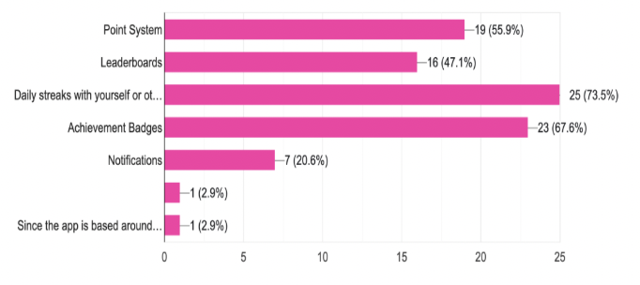
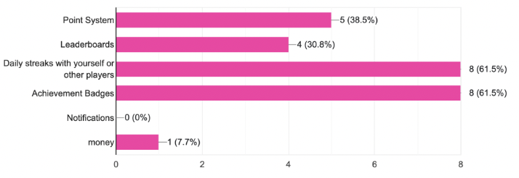
Gamified App Users
Not Gamified App Users
Notes:
Overwhelmingly, features like daily streaks, leaderboards and point systems, and achievement badges drive gamified app users and non-users to participation.

Slide 17
PRIMARY RESEARCH: Qualitative
15 college students
“The profile page looks like Instagram”
“I would like using the app to do challenges, but would want to submit photos, not only live streaming.”
“I like the little octopus”

Slide 18
STRATEGY & CREATIVES

Slide 19
THE CHALLENGE

Slide 20
THE CHALLENGE
IN A MARKET SATURATED WITH COUNTLESS
APPS COMPETING FOR ATTENTION, OUR GOAL
IS TO CREATE STRONG BRAND PRESENCE THAT
NOT ONLY ATTRACTS USERS TO DOWNLOAD
THE APP BUT ALSO KEEPS THEM ACTIVELY
ENGAGED OVER TIME.

Slide 21
TARGET AUDIENCE

Slide 22
TARGET AUDIENCE

Slide 23
COMPETITIVE ANALYSIS

Slide 24


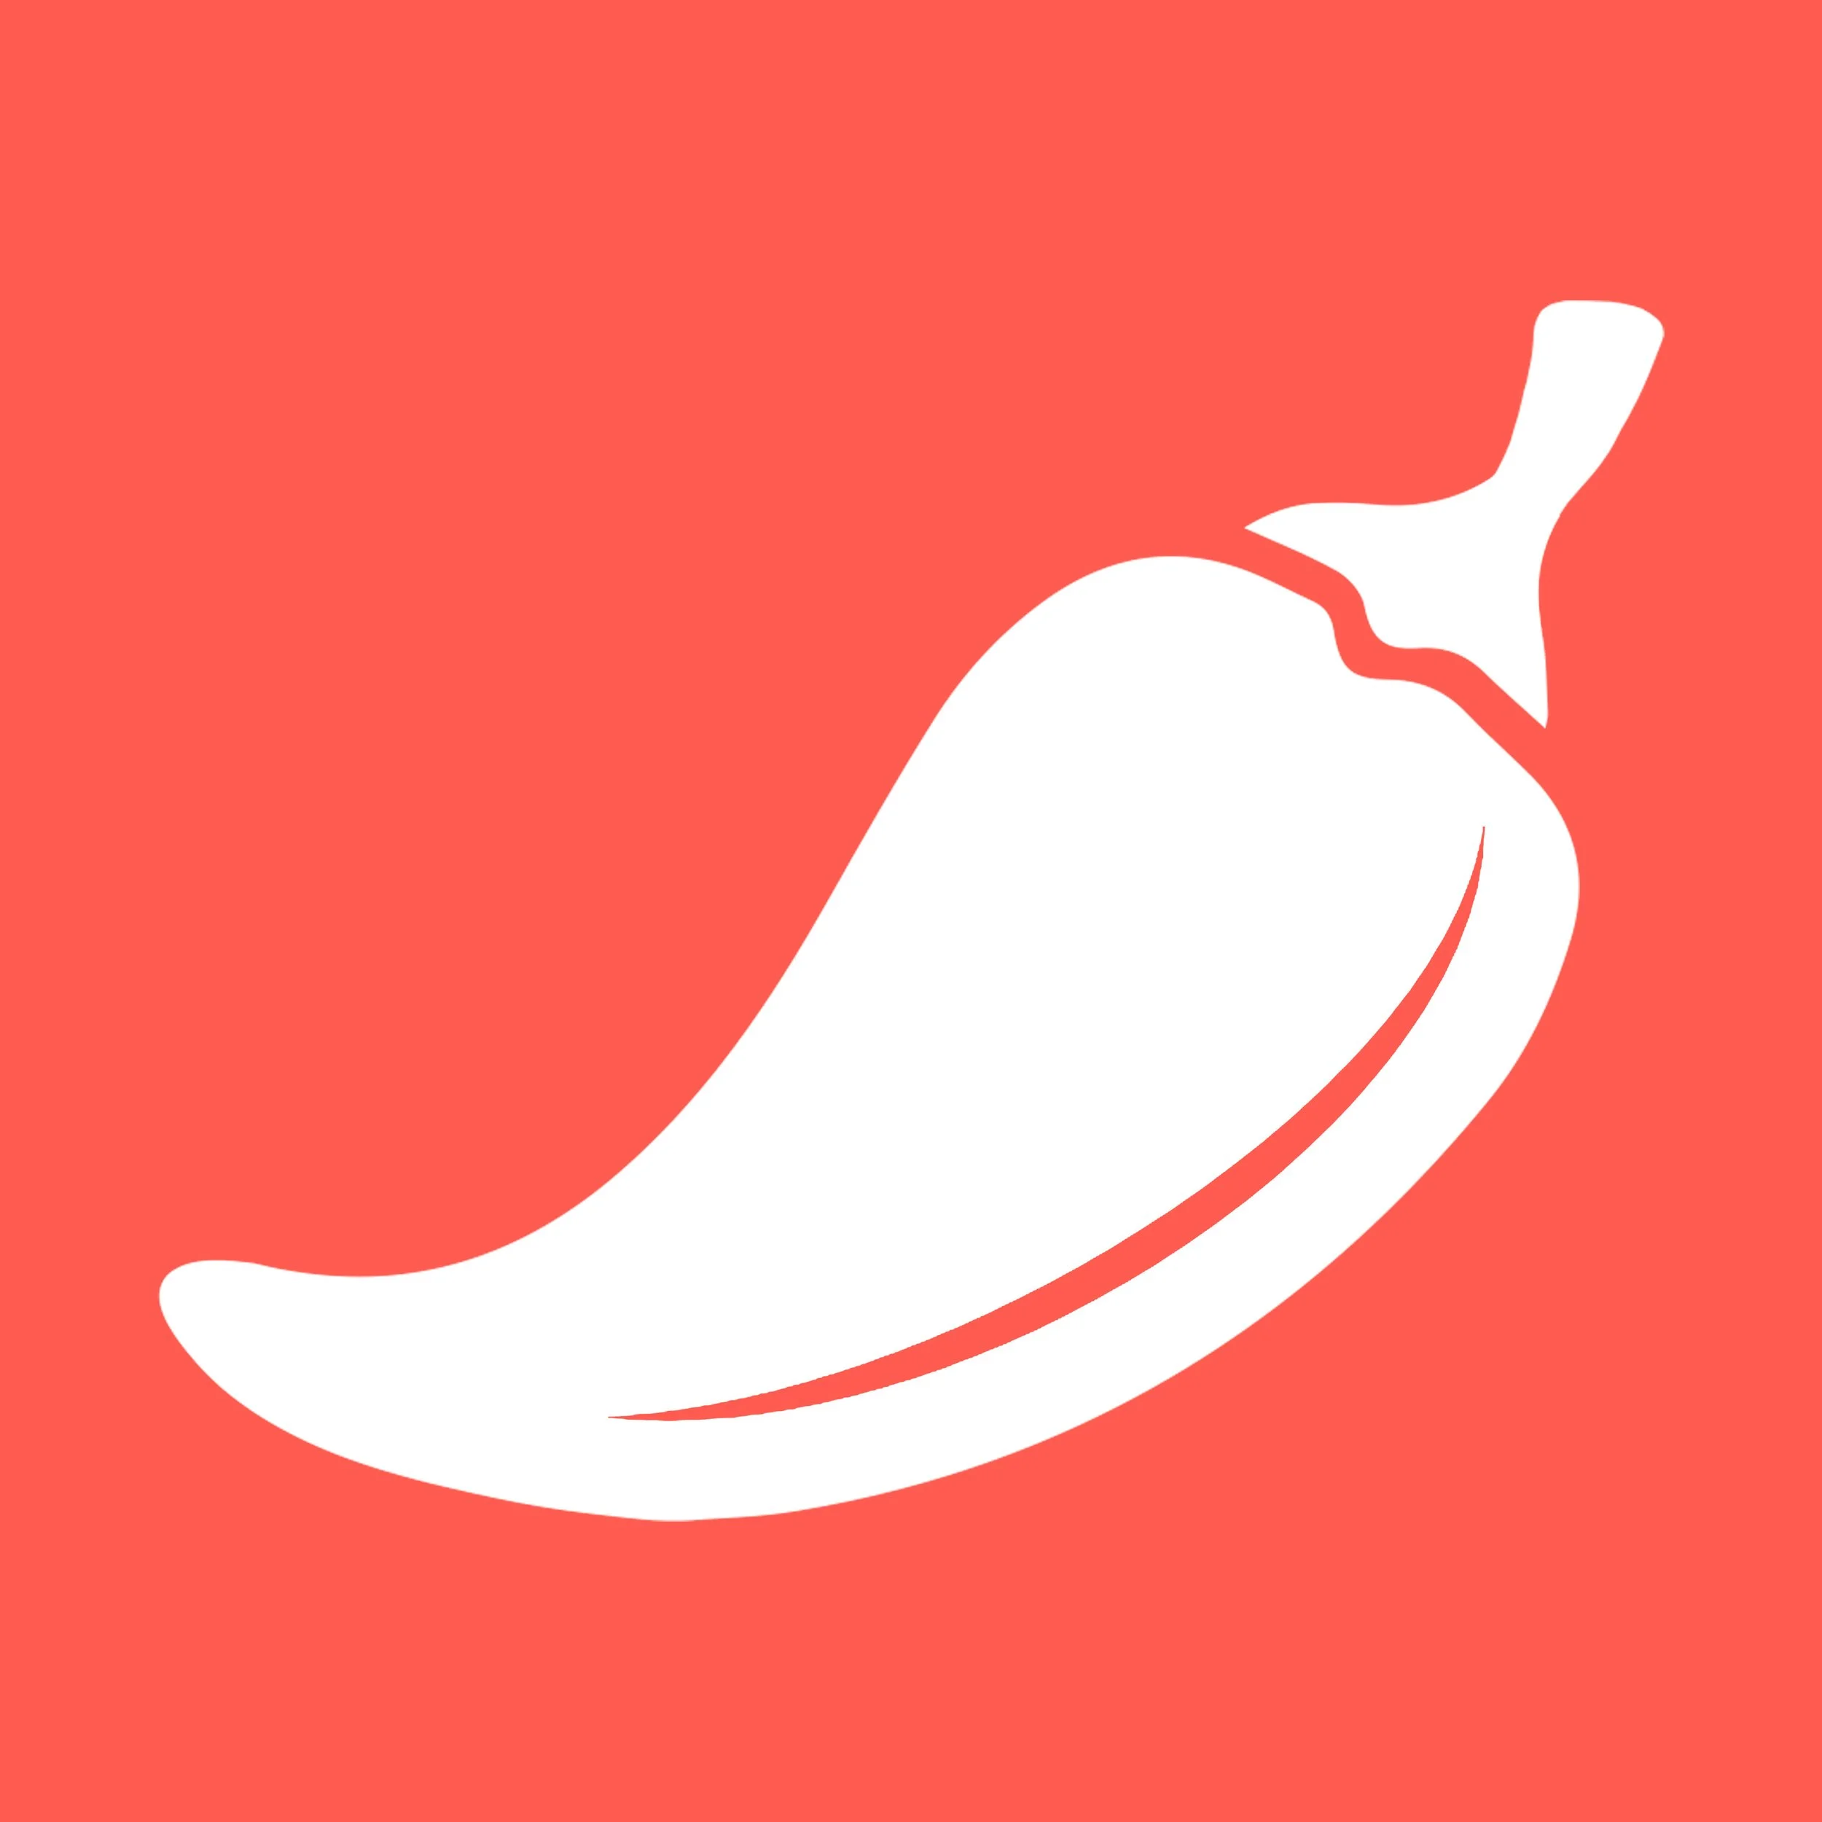



SIZZL’S COMPETITORS

Slide 25
INSTAGRAM, TIKTOK, YOUTUBE, TWITCH
Archetype: Jester
Core Desire: Enjoyment
Characterized by: Fun, Humorous, Playfulness, Entertainment
Tiktok: #1 Entertainment in App Store
Instagram: #3 Photo & Video in App Store
Youtube: #5 Photo & Video in App Store
Twitch: #12 Photo & Video in App Store
SIZZL’S ADVANTAGE: allows users to mix competition AND social media, exclusive food content
https://www.tiktok.com/about?lang=en
https://about.instagram.com/about-us
https://about.youtube/
https://www.twitch.tv/p/en/stream/

Slide 26
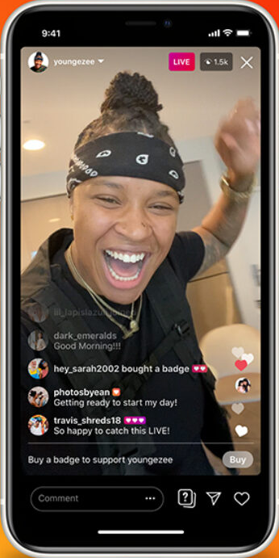
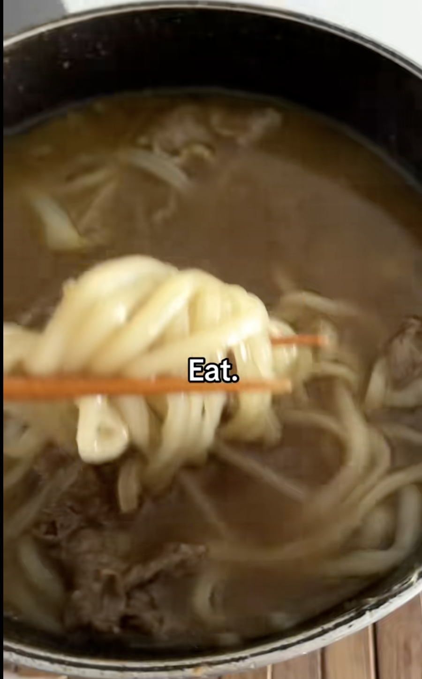
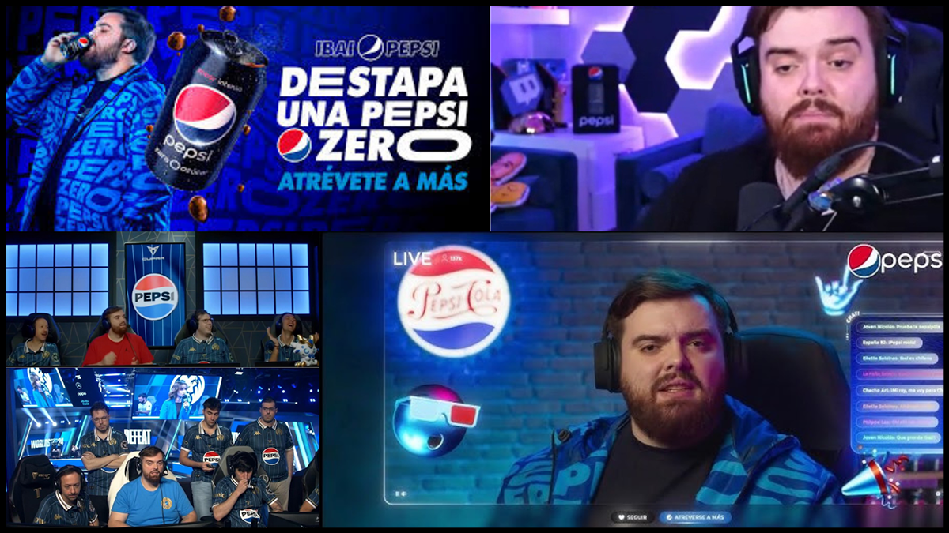
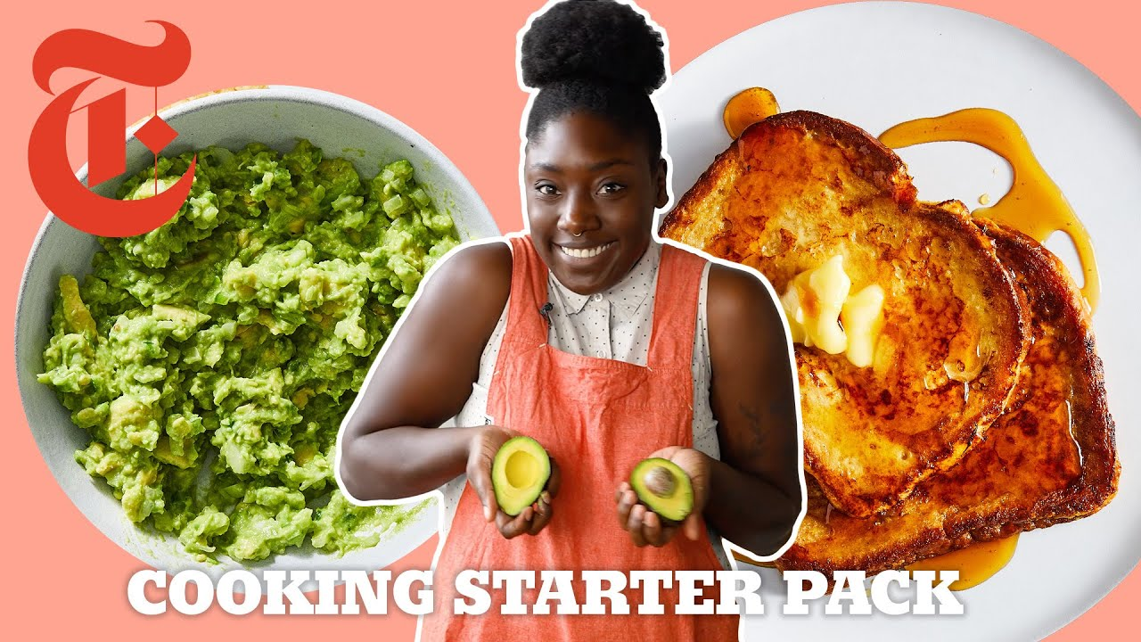
INSTAGRAM LIVE
TIKTOK COOKING VIDEO
TWITCH BRAND SPONSOR
YOUTUBE COOKING CONTENT
TikTok Cooking Video
Notes:
LABEL

Slide 27
PEPPER
Archetype: Sage
Core Desire: Understanding
Characteristics: Knowledge, Information, Expertise, Wisdom
#143 Food & Drink in App Store
Refer to themselves as a community
Share meals, digital social cookbooks
50,000+ recipes
  Able to filter based off dietary restrictions
SIZZL’S ADVANTAGE: Live streaming allows users to cook along in real-time.
https://www.peppertheapp.com/

Slide 28
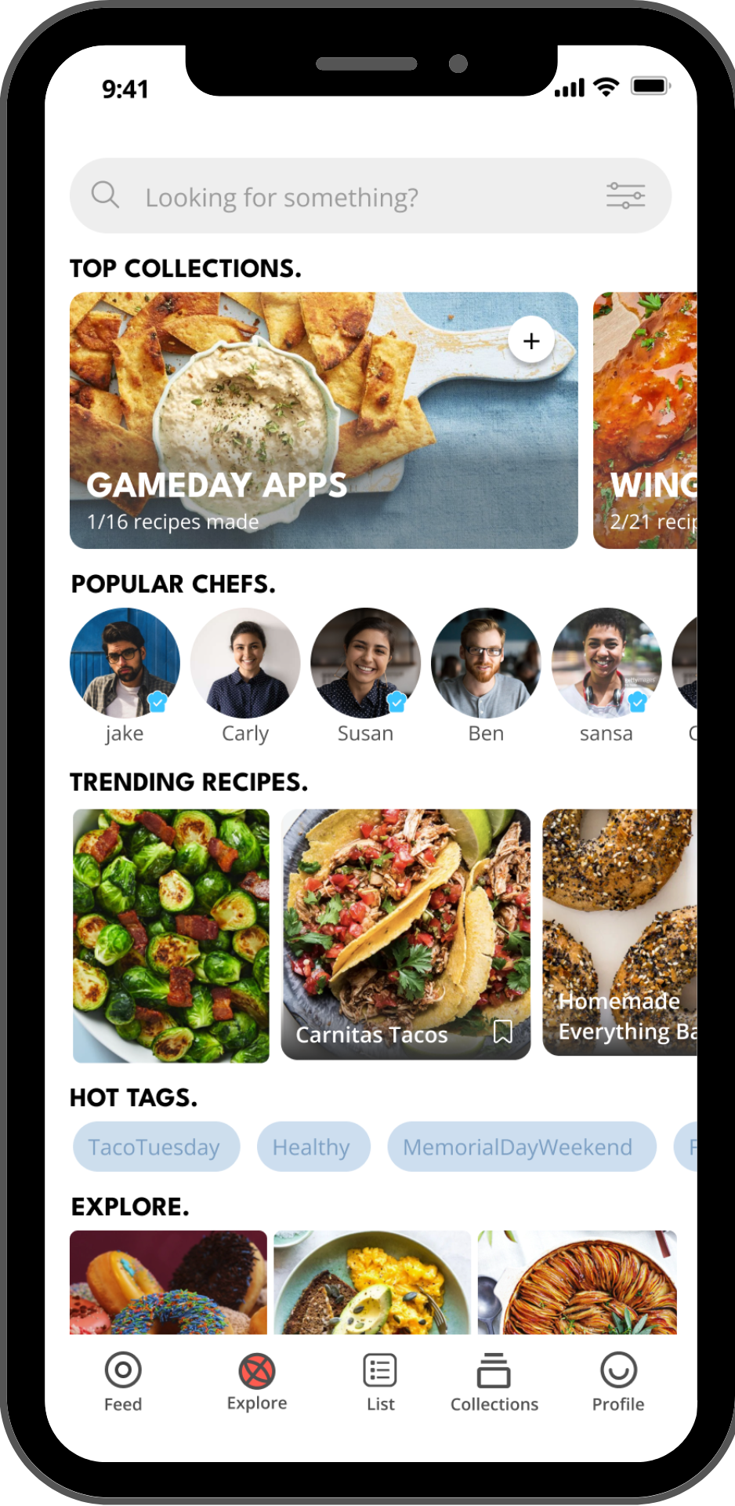
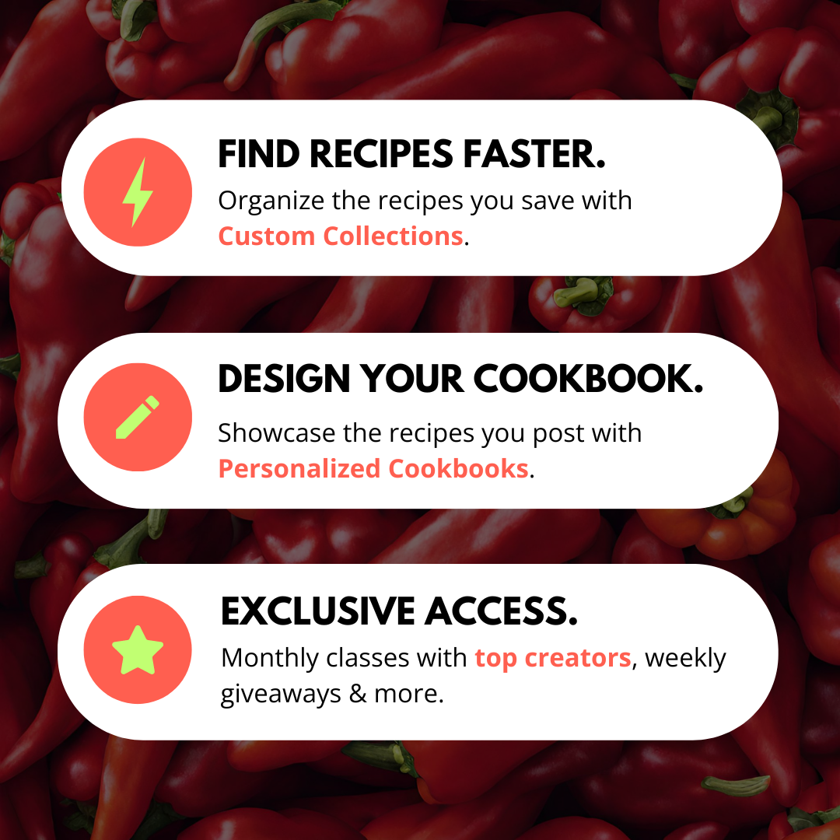
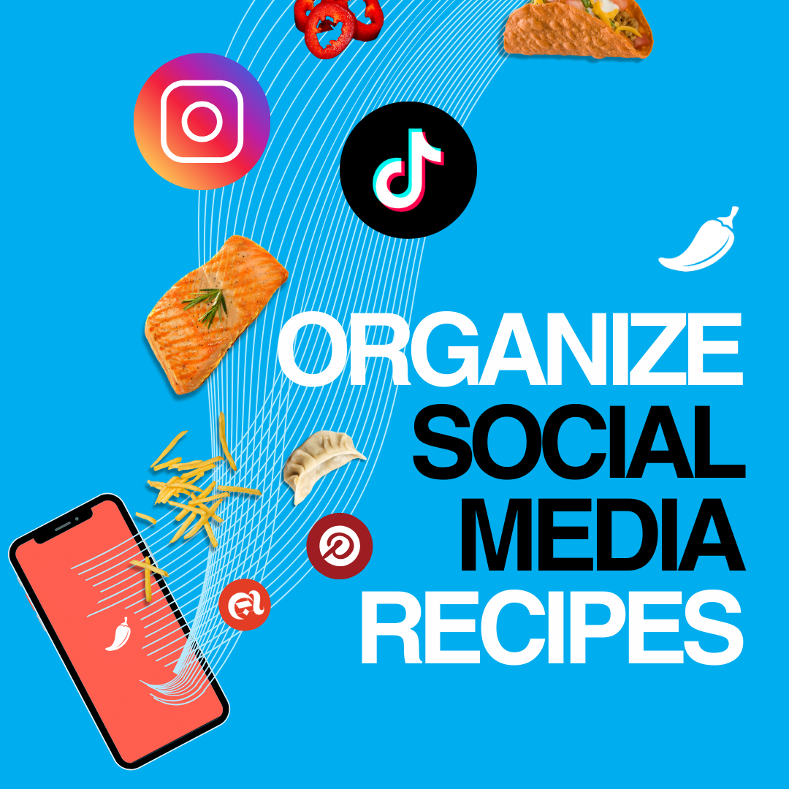
PEPPER MARKETING CONTENT
INSTAGRAM POST
SOCIAL MEDIA AD
APP HOMEPAGE

Slide 29
Beli
Archetype: Everyman
Core Desire: Belonging
Characteristics: Dependable, Inclusive, Useful, Citizen
#51 in Food & Drink in App Store
Exclusive to restaurants
Similar to Yelp, but adding the concept of friends in it
Primarily ranking/restaurant focused
SIZZL’S ADVANTAGE: No competition or user creation
https://beliapp.com/

Slide 30
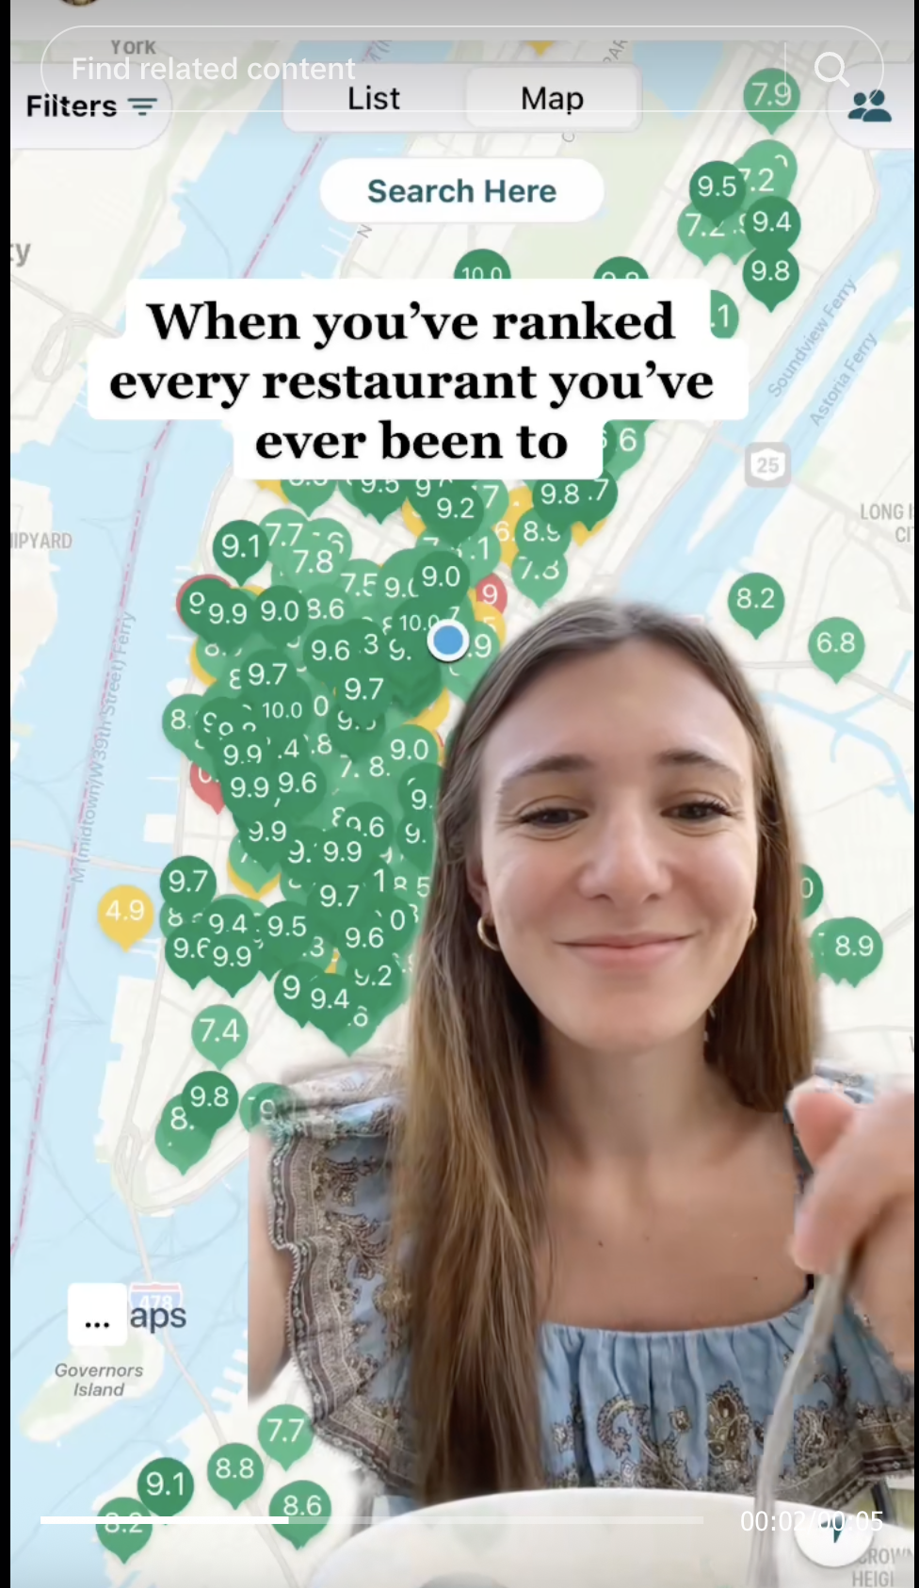
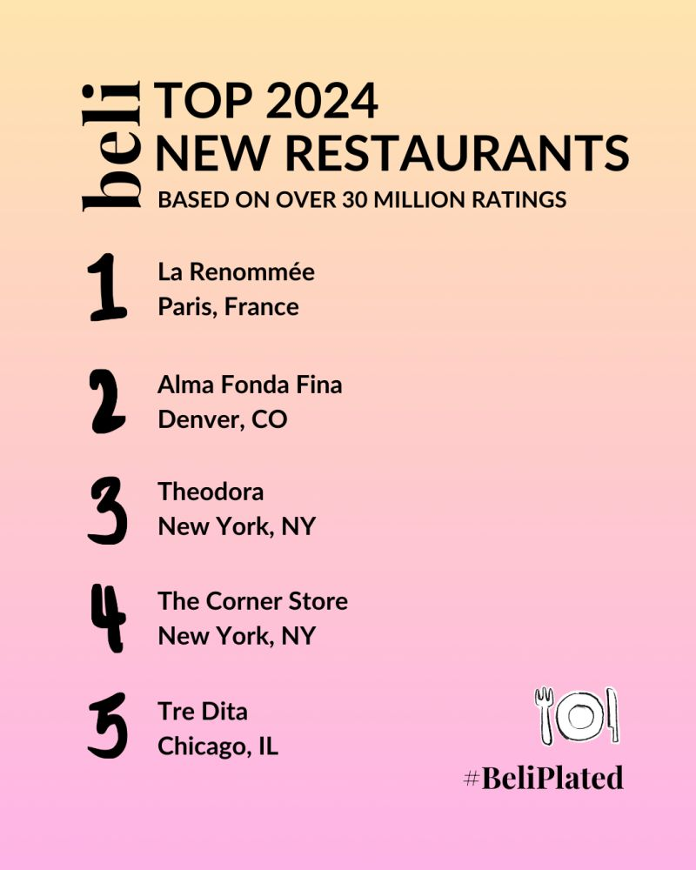
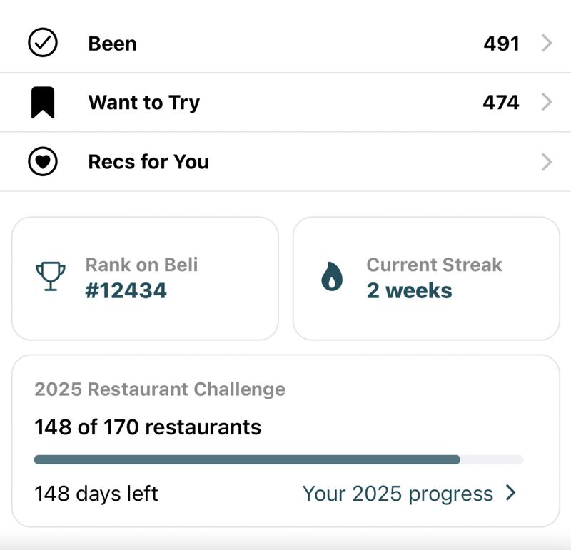
Beli Marketing Content
LINKED IN AD
TIKTOK AD
INSTAGRAM AD

Slide 31
SIZZL’S COMPETITORS
SOCIAL MEDIA HUBS
Fun and interactive, but no competition
PEPPER
Organization of 50,000 recipes, but minimal opportunities to connect with others.
BELI
High engagement, useful, but no user creations

Slide 32
RECOMMENDED POSITION #1

Slide 33


RECOMMENDED POSITION 1:
COMPETITIVE FUN WITH FRIENDS
Core Desire: Positive Change | Characterized by: Imaginative, Vision, Idealistic
VS

Slide 34
KEY MESSAGE
SIZZL TRANSFORMS FOOD
FROM PASSIVE ENTERTAINMENT TO INTERACTIVE, GAMIFIED, GLOBAL EXPERIENCE WHERE
EVERYONE CAN COOK AND COMPETE IN REAL-TIME.
XXX.

Slide 35
TAGLINE
“THE MOST FUN YOU’LL EVER HAVE WITH A FRYING PAN”

Slide 36
POSITIONING 1: WHY?
HOW DOES THIS POSITIONING DIFFERENTIATE FROM COMPETITORS?
Capitalizes on existing, successful, and recognizable trends in gamified apps but adds a uniquely SIZZL’d twist by leaning into their position as a cooking platform.

Slide 37
OUTSIDE CREATIVE:
Still a work in progress

Slide 38
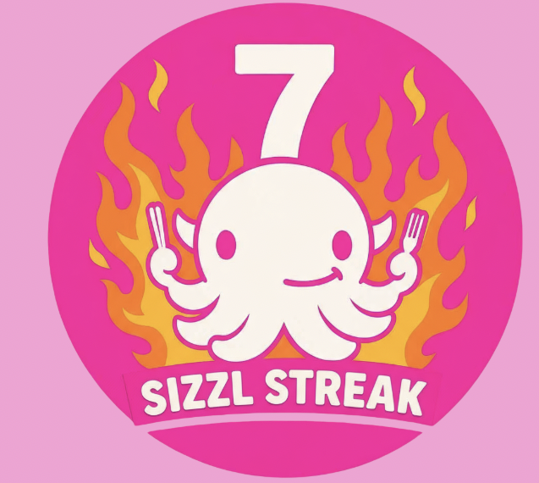
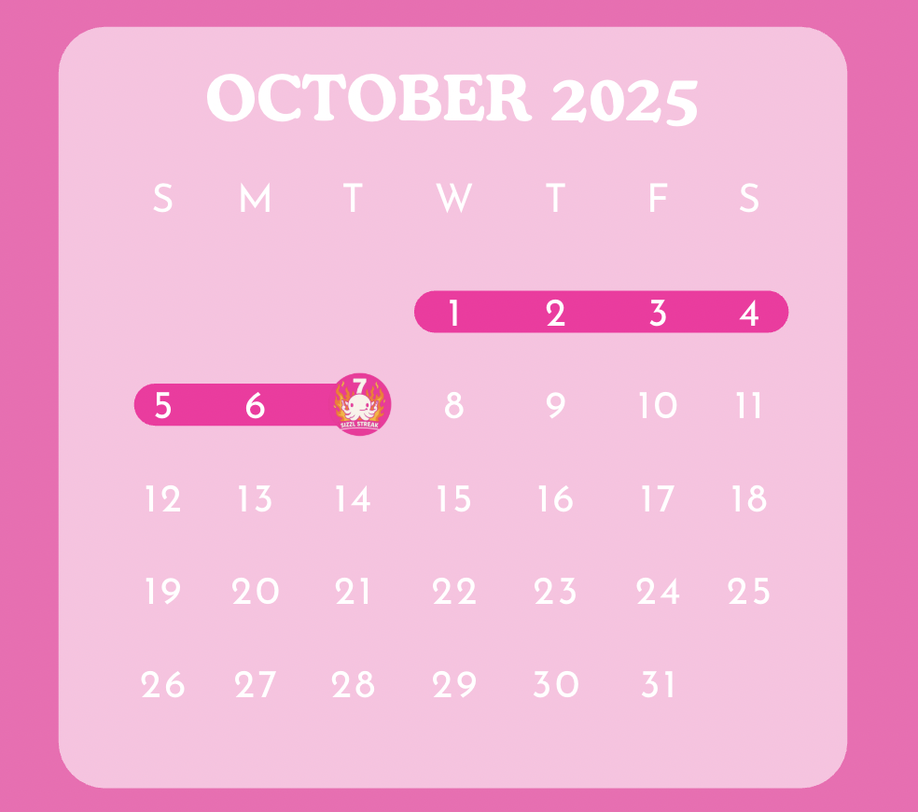
IN-APP CREATIVE 1:
SIZZL STREAK

Slide 39
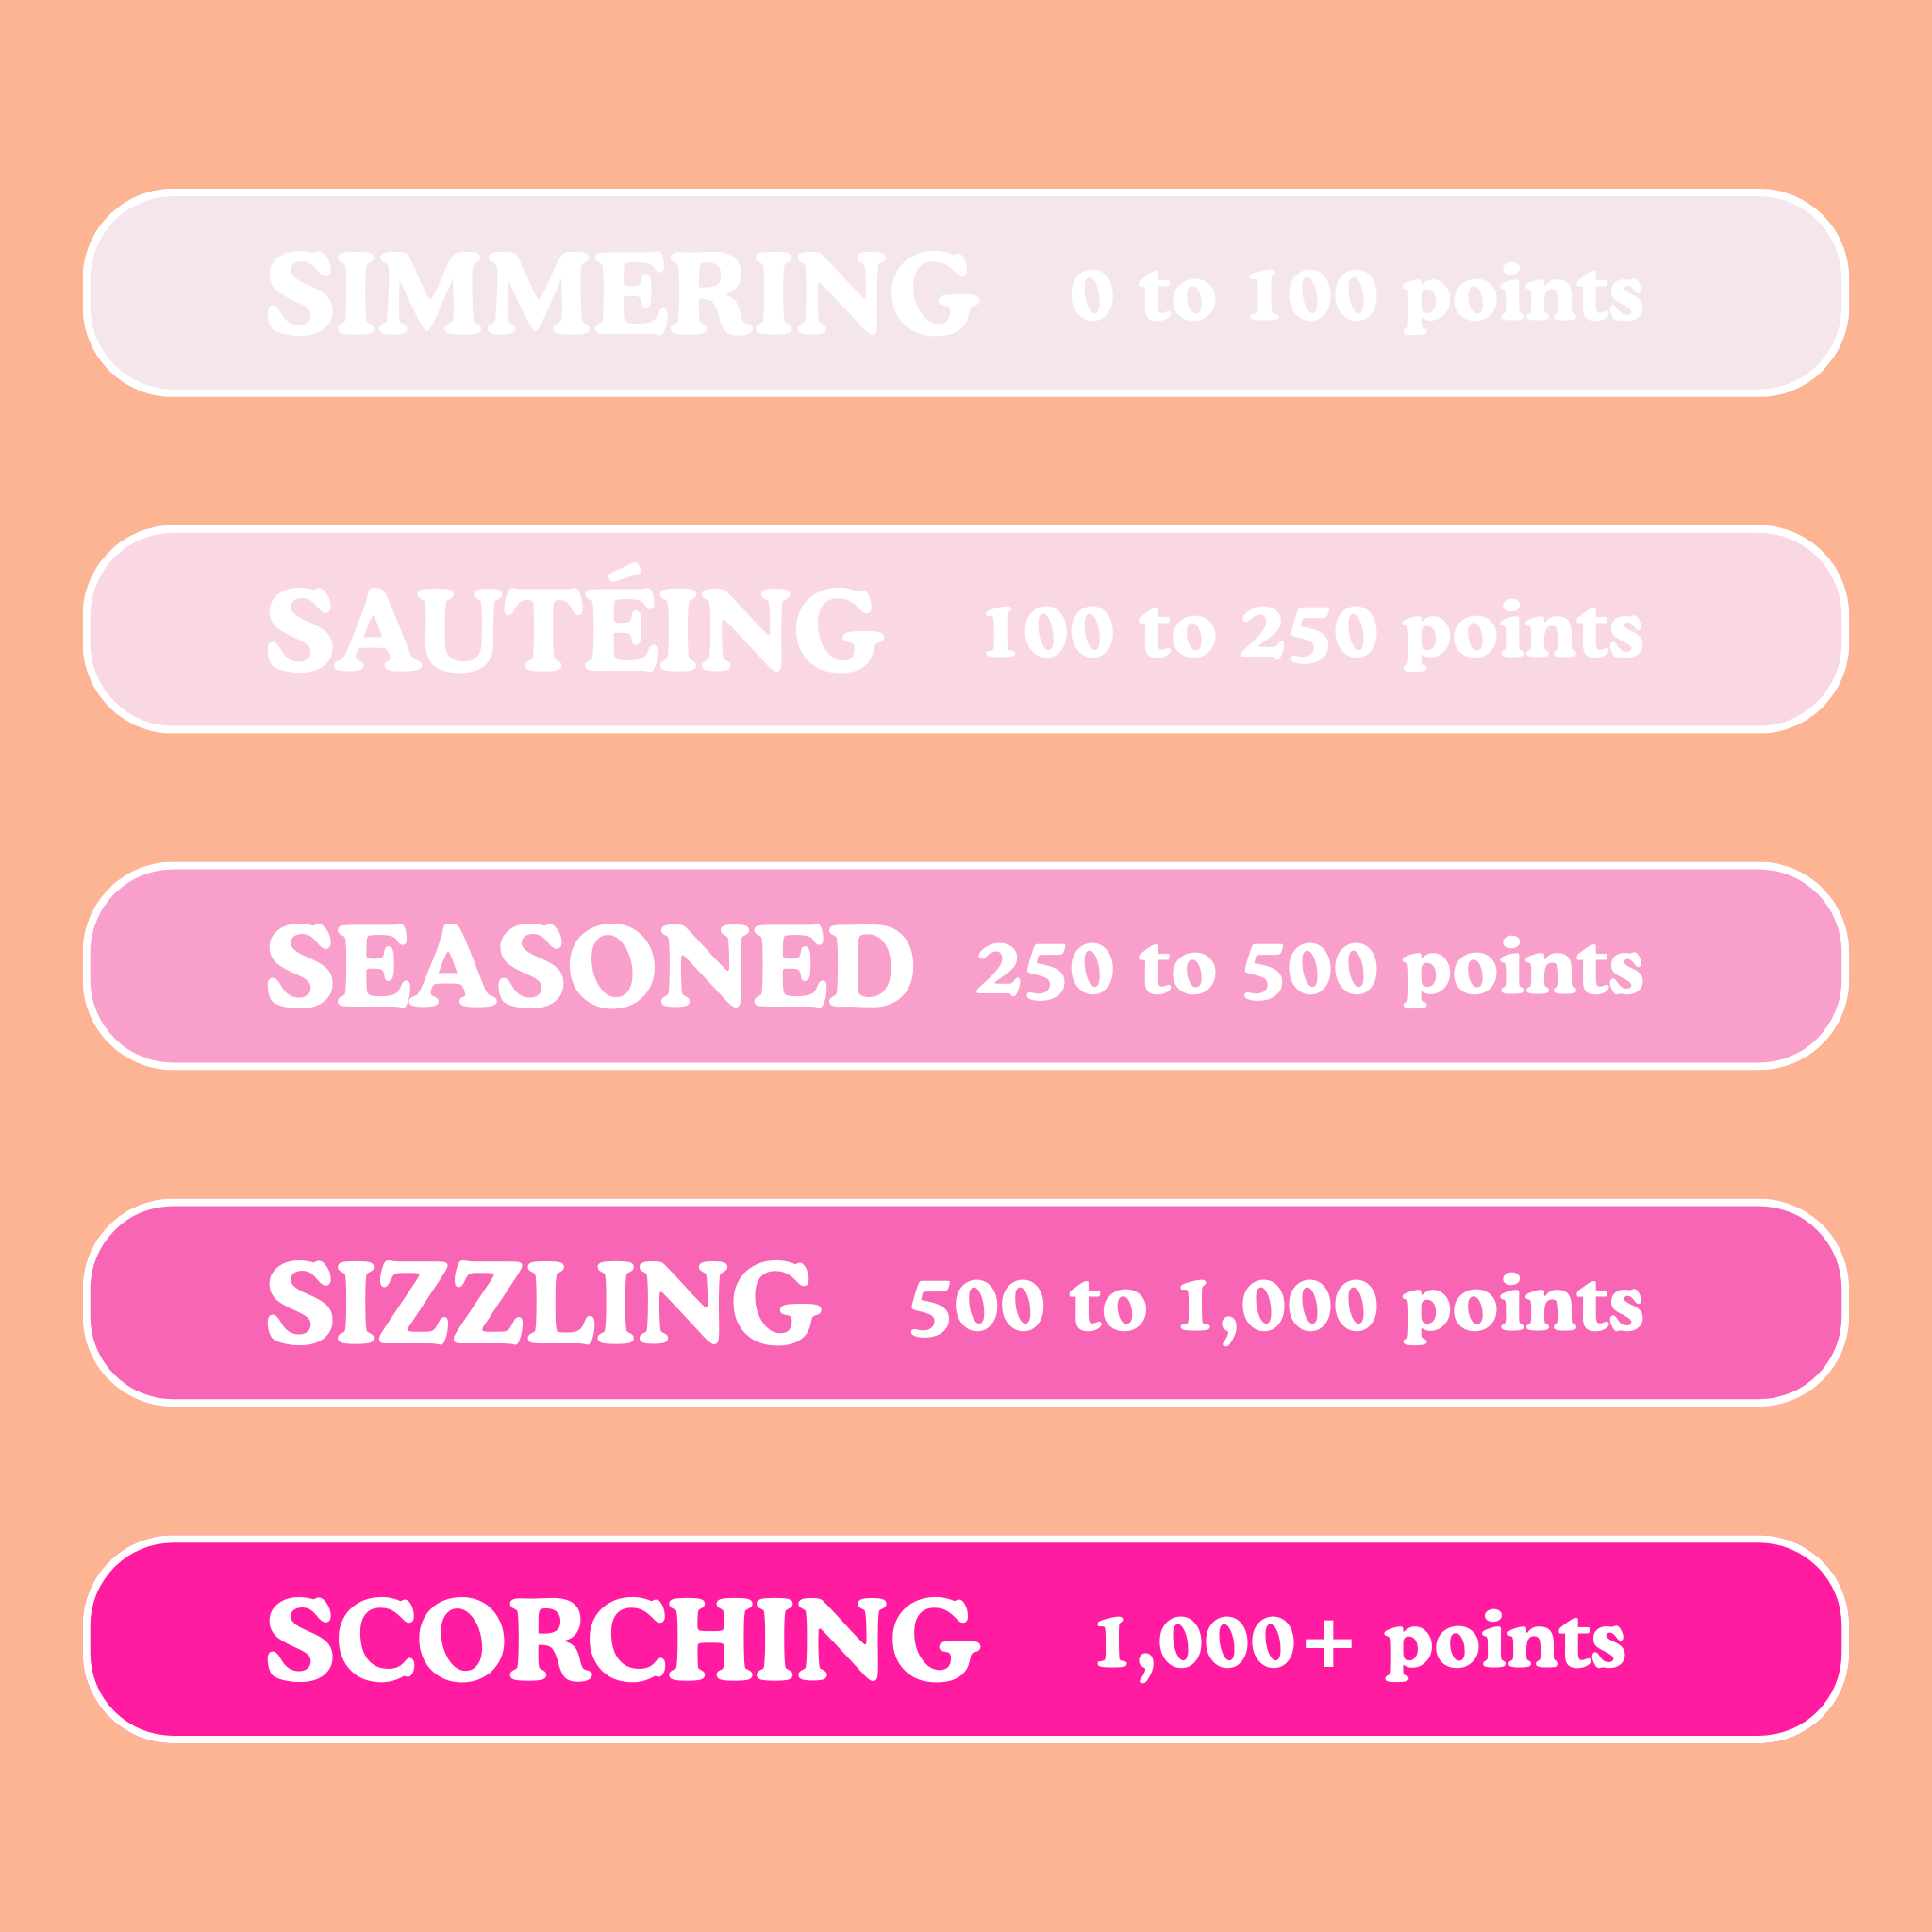
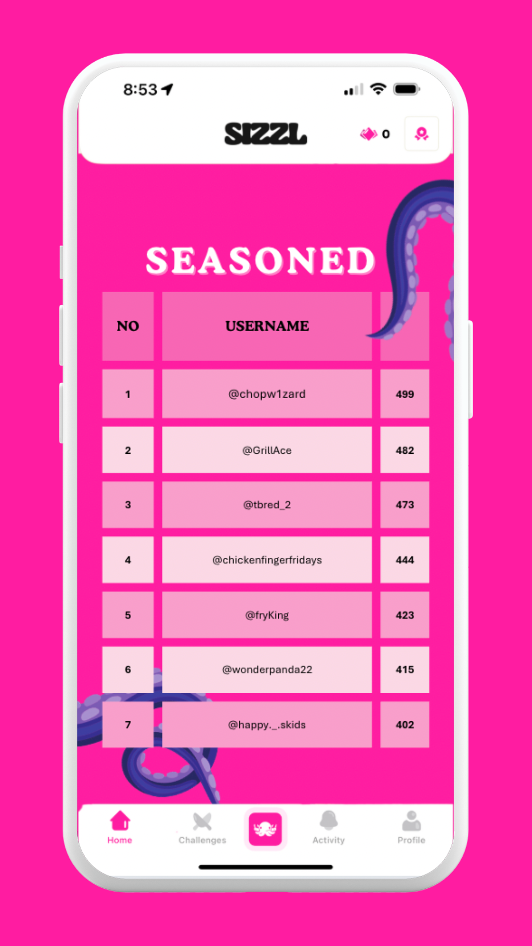
IN-APP CREATIVE 2:
SPICE POINTS AND SIZZL STANDINGS

Slide 40
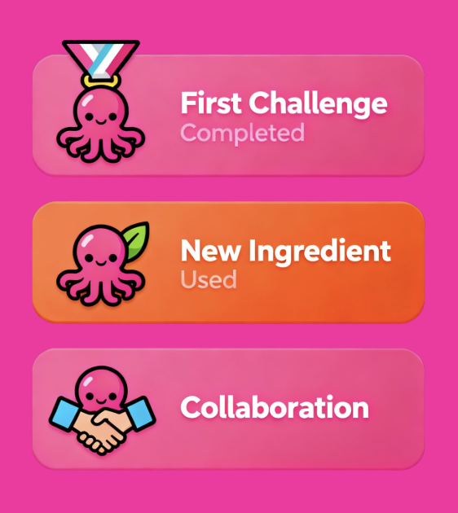
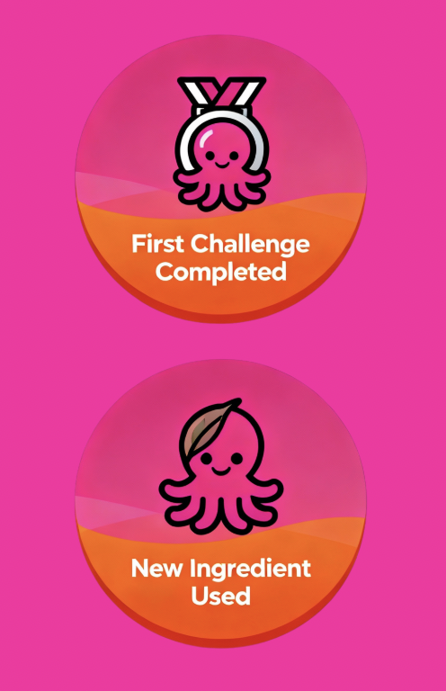
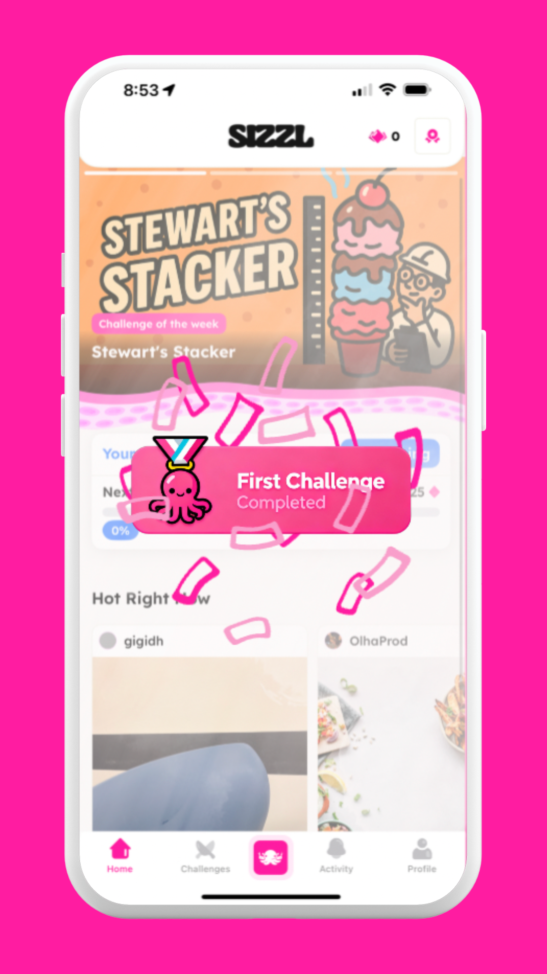
IN-APP CREATIVE 3:
SIZZL STAMPS

Slide 41
POSITIONING 1: WHY?
WHY WILL THIS POSITIONING WORK?
In our primary research:
  66.7% of gamified app users and non-users are incentivized by daily streaks
  66.7% by achievement badges
  50% by point system
  42.9% by leaderboards
Our primary research is echoed by secondary research, which show “engaged users develop greater intentions to continue using the gamified mobile app, recommend it to others, say positive things about it, and are more prone to evaluate the app positively.”
https://doi.org/10.1016/j.jbusres.2021.04.028

Slide 42
RECOMMENDED POSITION #2

Slide 43


RECOMMENDED POSITION 2:
CREATIVE COOKING COMMUNITY
Core Desire: Enjoyment | Characterized by: Fun, Entertainment, Playfulness

Slide 44
KEY MESSAGE
SIZZL IS A FOOD INNOVATION PLATFORM
THAT HARNESSES THE POWER OF CULINARY COMMUNITY TO TRANSFORM COOKING INTO A GLOBAL, INTERACTIVE EXPERIENCE, WHERE PLAYFULNESS AND CONNECTION
COME TOGETHER IN REAL-TIME.

Slide 45
TAGLINE
“CREATE, SIZZL, CONNECT.”

Slide 46
POSITIONING 2: WHY?
HOW DOES THIS POSITIONING DIFFERENTIATE FROM COMPETITORS?
Keeping the fun aspect of Social Media while emphasizing the company’s cooking centered platform allows cooking coinsures to enjoy the best of both worlds.

Slide 47
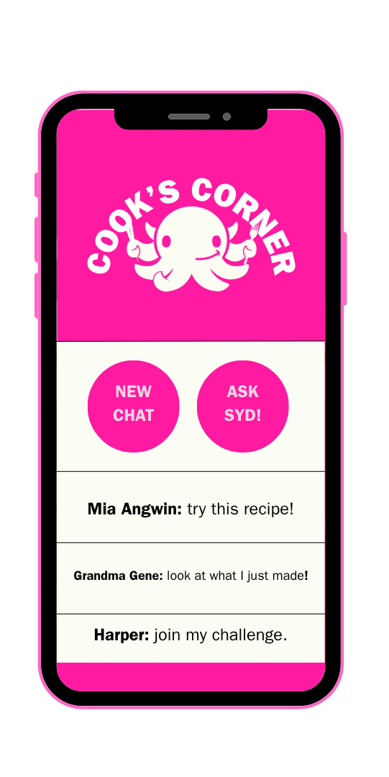
IN-APP CREATIVE 1:
COOKS CORNER
CREATE A DIRECT MESSAGING SYSTEM WHERE USERS CAN
CHAT WITH ONE ANOTHER, SHARE RECIPIES, AND CREATE THEIR OWN COOKING COMMUNITIES.

Slide 48
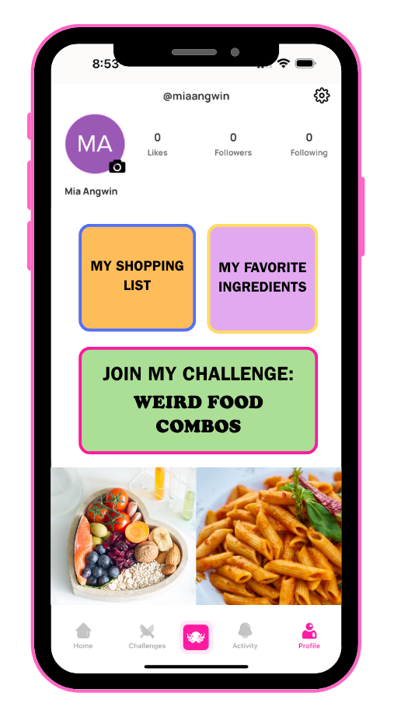
IN-APP CREATIVE 2:
ENHANCE PERSONAL PROFILE
ENHANCE THE PERSONAL PROFILE TO CATER MORE TOWARDS COOKING CONTENT. ALLOW USERS TO SHARE THEIR CURRENT FAVORITES, AND PICTURES OF THEIR CHALLENGES.

Slide 49
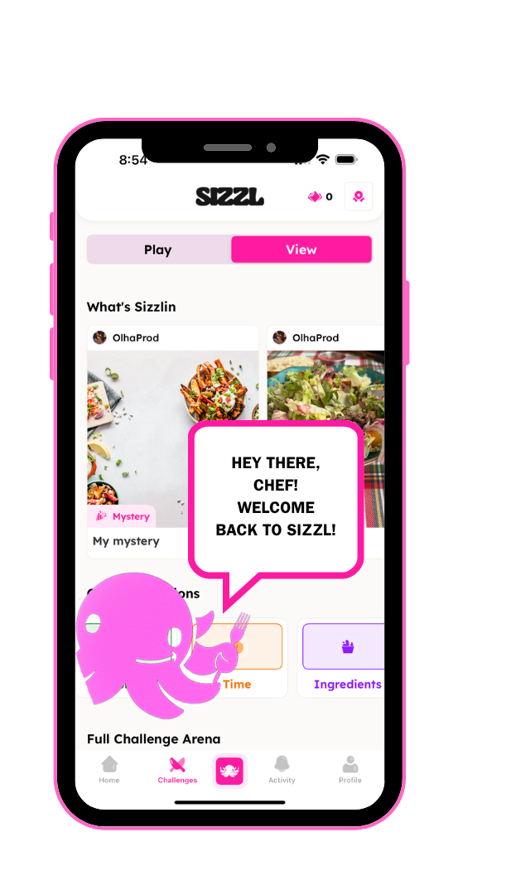
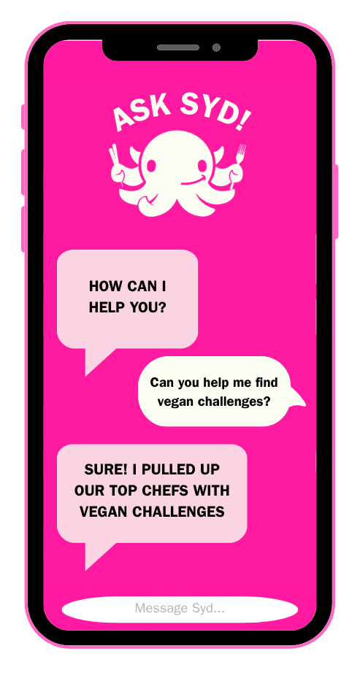
IN-APP CREATIVE 3:
PERSONIFY SYD

Slide 50
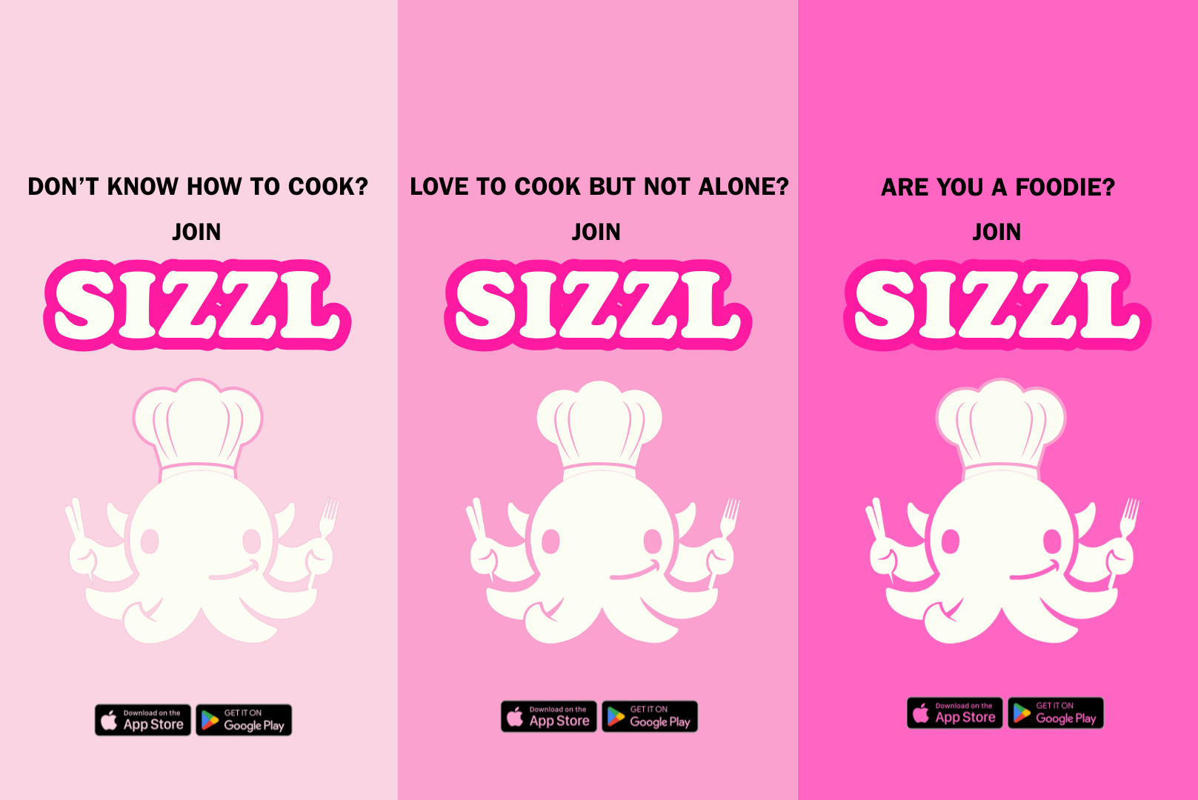
OUTSIDE CREATIVE 3:
PERSONIFY SYD

Slide 51
POSITIONING 2: WHY?
WHY WILL THIS POSITIONING WORK?
In our qualitative primary research, we found that individuals enjoy the premise of the app but would prefer to post their photos and not be limited to live stream. Similarities to the Instagram profile page were seen. Participants also really loved Syd, the Octopus.
In our secondary research, we found that, “cultivating intrinsic motivation maintains a user’s interest and involvement over an extended period of time… the need for social connection, can be promoted through social features that enable progress sharing, mutual support, and community engagement.”
https://www.jmir.org/2024/1/e64196

Slide 52
CONCLUSION

Slide 53
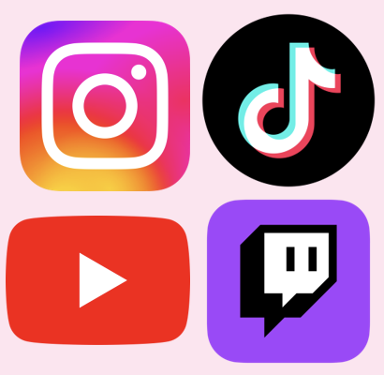

Turning food into play
Sizzl modernizes food the content legacy for a digital generation.
RECOMMENDED POSITION 1:​
COMPETITIVE FUN WITH FRIENDS​
RECOMMENDED POSITION 2:​
CREATIVE COOKING COMMUNITY

