Slide 1
TogaNola
Hayden, Gigi, Mohamed, Issac

Slide 2


Agenda
Discovery
Industry Analysis
Company Insights
Cultural Context
Strategy and Creatives:
The challenge
Target Audience
Competitive Analysis
Positioning #1
Positioning #2
Conclusion

Slide 3
Industry Analysis

Slide 4
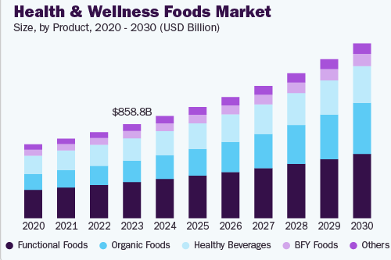
General Snack Market
6 in 10 people globally prefer smaller meals or snacks during the day
Top traits: Sweet, salty, and crunchy
Health and wellness food market is rising
US has the largest snack market
North America accounts for over 35 % of total market revenue
https://www.grandviewresearch.com/industry-analysis/health-wellness-foods-market-report
https://ific.org/wp-content/uploads/2025/04/IFIC-Snacking-Spotlight-Survey.pdf
https://foodinstitute.com/focus/rapid-pace-of-life-drives-convenient-snacks/#:~:text=Approximately%206%20in%2010%20global,of%20the%20consumer's%20digital%20experience.
https://www.futuremarketinsights.com/reports/granola-market

Slide 5
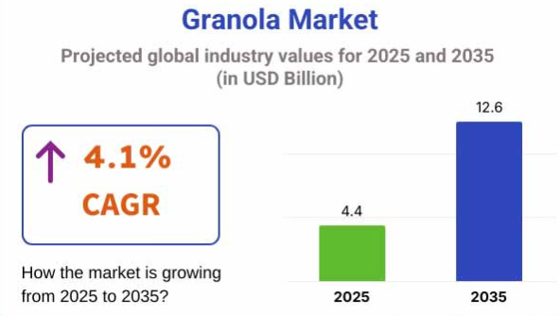
https://www.statista.com/topics/1496/snack-foods/#topicOverview

Slide 6
Company Insights

Slide 7
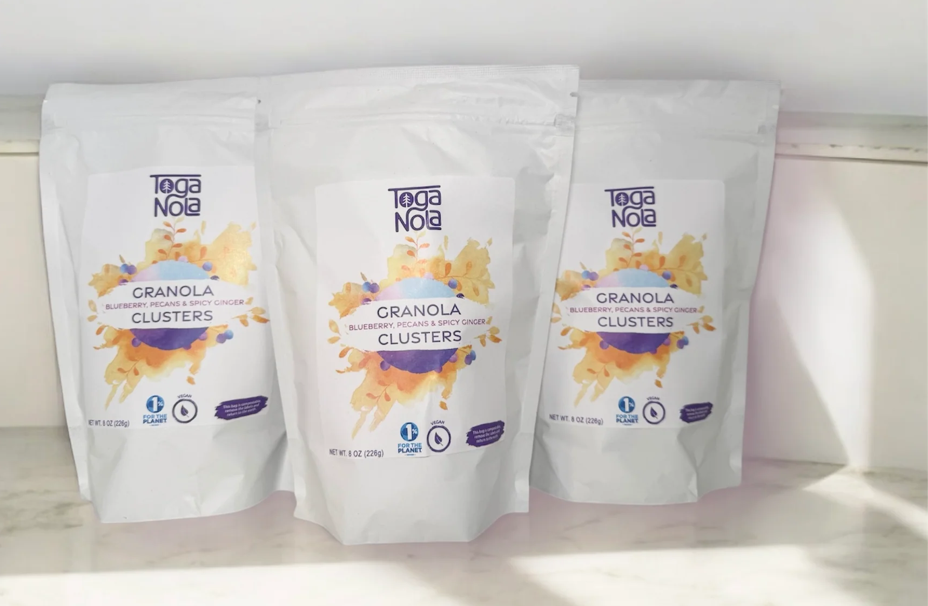
TOGANOLA
Founded in 2015 by Katie Rhodes
Now owned by Jessica Schwartzman, who is committed to quality and community
Expanded product line with new granola bar flavors and “granola bombs”
Strengthened local partnerships and sustainability initiatives in Saratoga Springs
Focuses on premium ingredients, eco-friendly practices, and innovative growth in the healthy snack market

Slide 8
TogaNola’s Values
Community: building relationships and giving back to Saratoga
Small Batch Quality: premium, fresh ingredients
Sustainability: compostable bags

Slide 9
Cultural Context

Slide 10


CULTURAL History
Originated in 1863 by Dr. James Caleb Jackson (“granula”) in upstate NY
Name changed to “granola” after trademark disputes with Kellogg
Revived in the 1960s during the health-focused counterculture movement
1970s: Rise of commercial granola bars as convenient, energy-boosting snacks
Notes:
Add numbers (DATA)

Slide 11
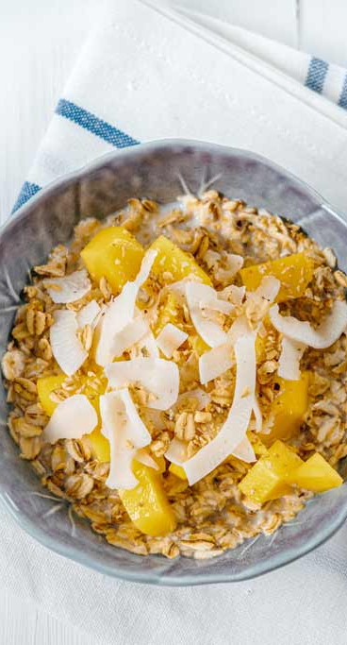
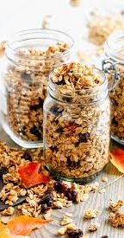
Current Trends
Consumers seek healthy, sustainable, and convenient snacks
Demand for low-sugar, high-protein, gluten-free, fiber-rich options
Rising use of plant-based, probiotic, and superfood ingredients
Preference for eco-friendly packaging and clean-label/organic/non-GMO products
Growth driven by veganism, urban lifestyles, and on-the-go snacking
Notes:
Global granola market projected to grow from $17B (2024) → $34B (2035) (≈6.5% CAGR)

Slide 12
Target Audience

Slide 13
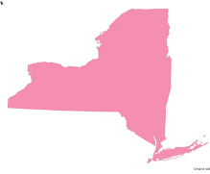
Demographic
Age: Primary 18-34, Secondary 35-55
  College Students, Young Professionals, Athletes, and Families
Location: New York and the Northeast
Income: Higher-end
  Willing to pay a premium for a better option
https://www.supplysidesj.com/supplement-regulations/bars-market-analysis
https://www.forbes.com/councils/theyec/2019/06/10/why-giving-back-increases-brand-loyalty/

Slide 14

Psychographic
Wellness, health, and clean ingredient conscious snackers
Busy individuals who need portable, easy to bring on the go snacks
People who care about the community and want to support brands that give back
https://micocf.org/blog/corporate-businesses-giving-back-to-the-community/
https://drugstorenews.com/consumers-crave-healthy-snacks
https://www.thepacker.com/news/retail/what-consumers-want-produce-snacking-options

Slide 15
Competitive Analysis

Slide 16



TogaNolas competitors

Slide 17
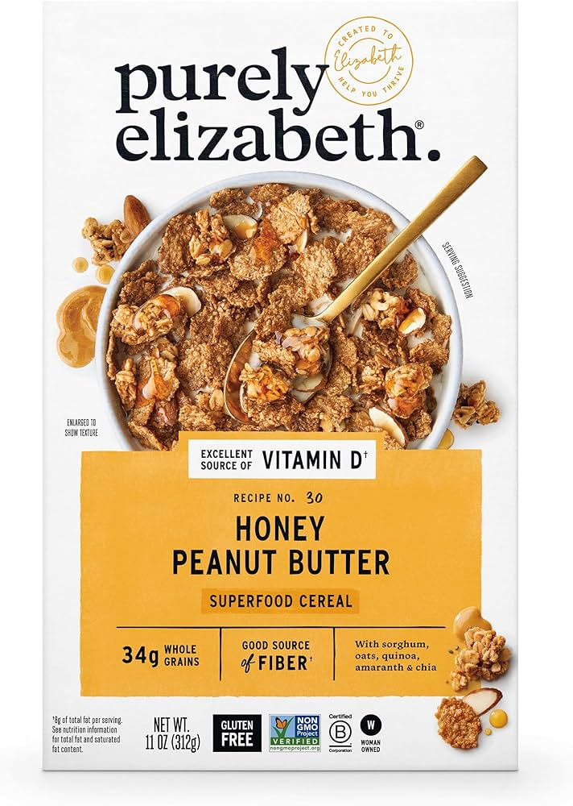
Purely Elizabeth
Archetype: Innocent
Core Desire: To experience purity and wellness
Characterized by: Wholesome, clean-label, organic, simple, optimistic
TogaNolas advantage: emphasizes, community outreach and giving back.
Notes:
https://purelyelizabeth.com/pages/journey?srsltid=AfmBOortB9cW_FiAjLh1SuJ-xGqNUkuIqKTOa1C56V6-rHUhP6emQmv9&utm

Slide 18

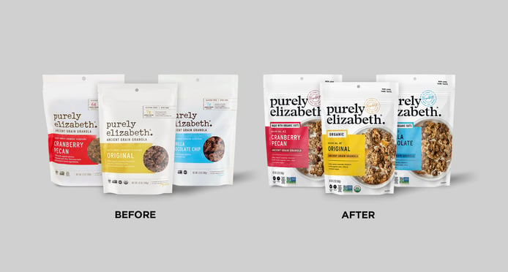
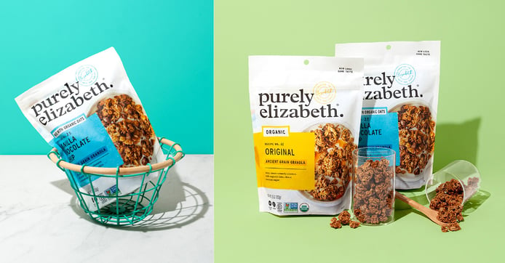
Purely Elizabeth Marketing content
Launched its first large-scale ad campaign titled “Savor the Start” in May 2024
Packaging & brand identity refresh: Refreshed packaging to improve shelf standout.
Strong positioning around wellness, clean ingredients, premium natural foods

Slide 19
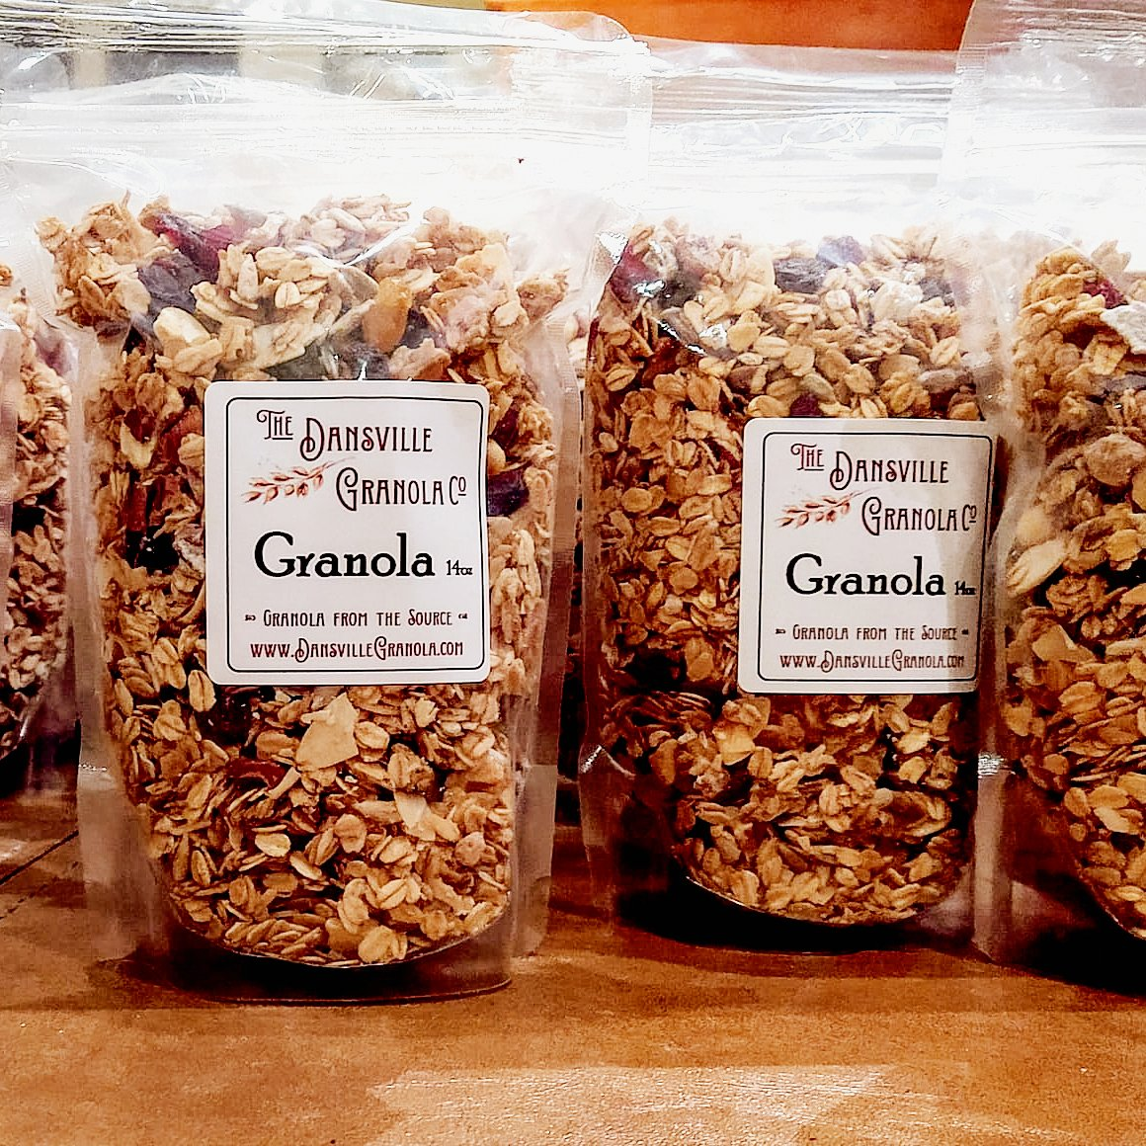
Dansville Granola
Archetype: The Caregiver
Core desire: Healthy snacks made with care and local sourcing
Characterized by: Small-batch, local ingredients
TogaNolas advantage:
Notes:
https://www.dansvillegranola.com/?utm

Slide 20
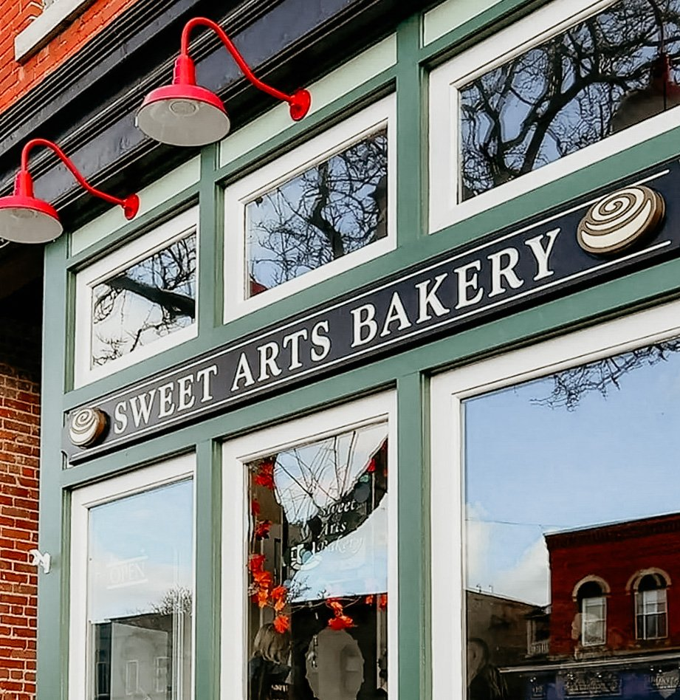
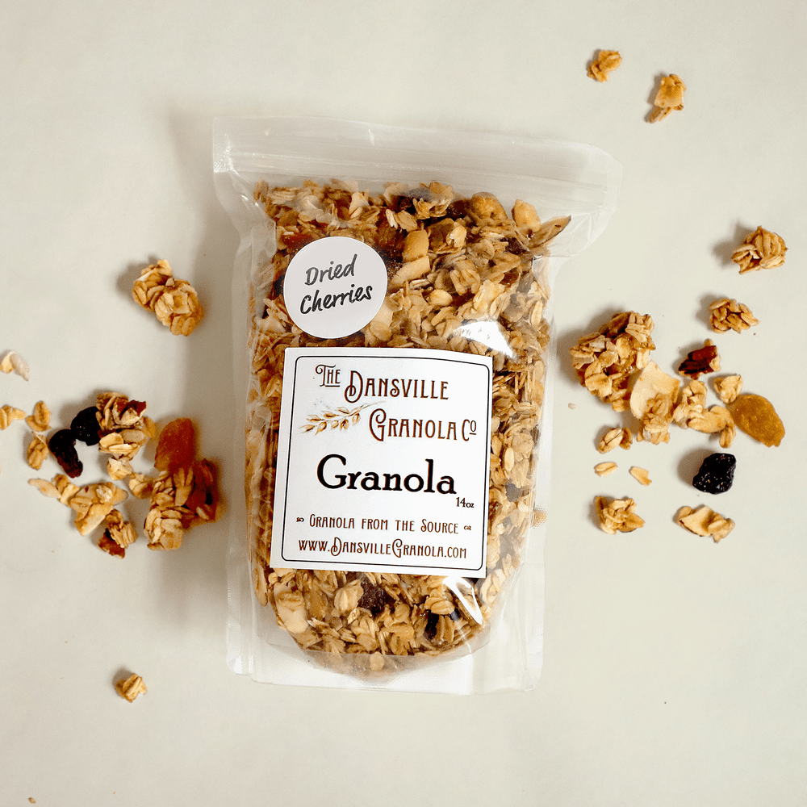
Dansville Granola marketing content
Own storefront in historic building downtown
Website “About” content focuses on the founder’s story
Small-batch production: locally sourced maple syrup

Slide 21
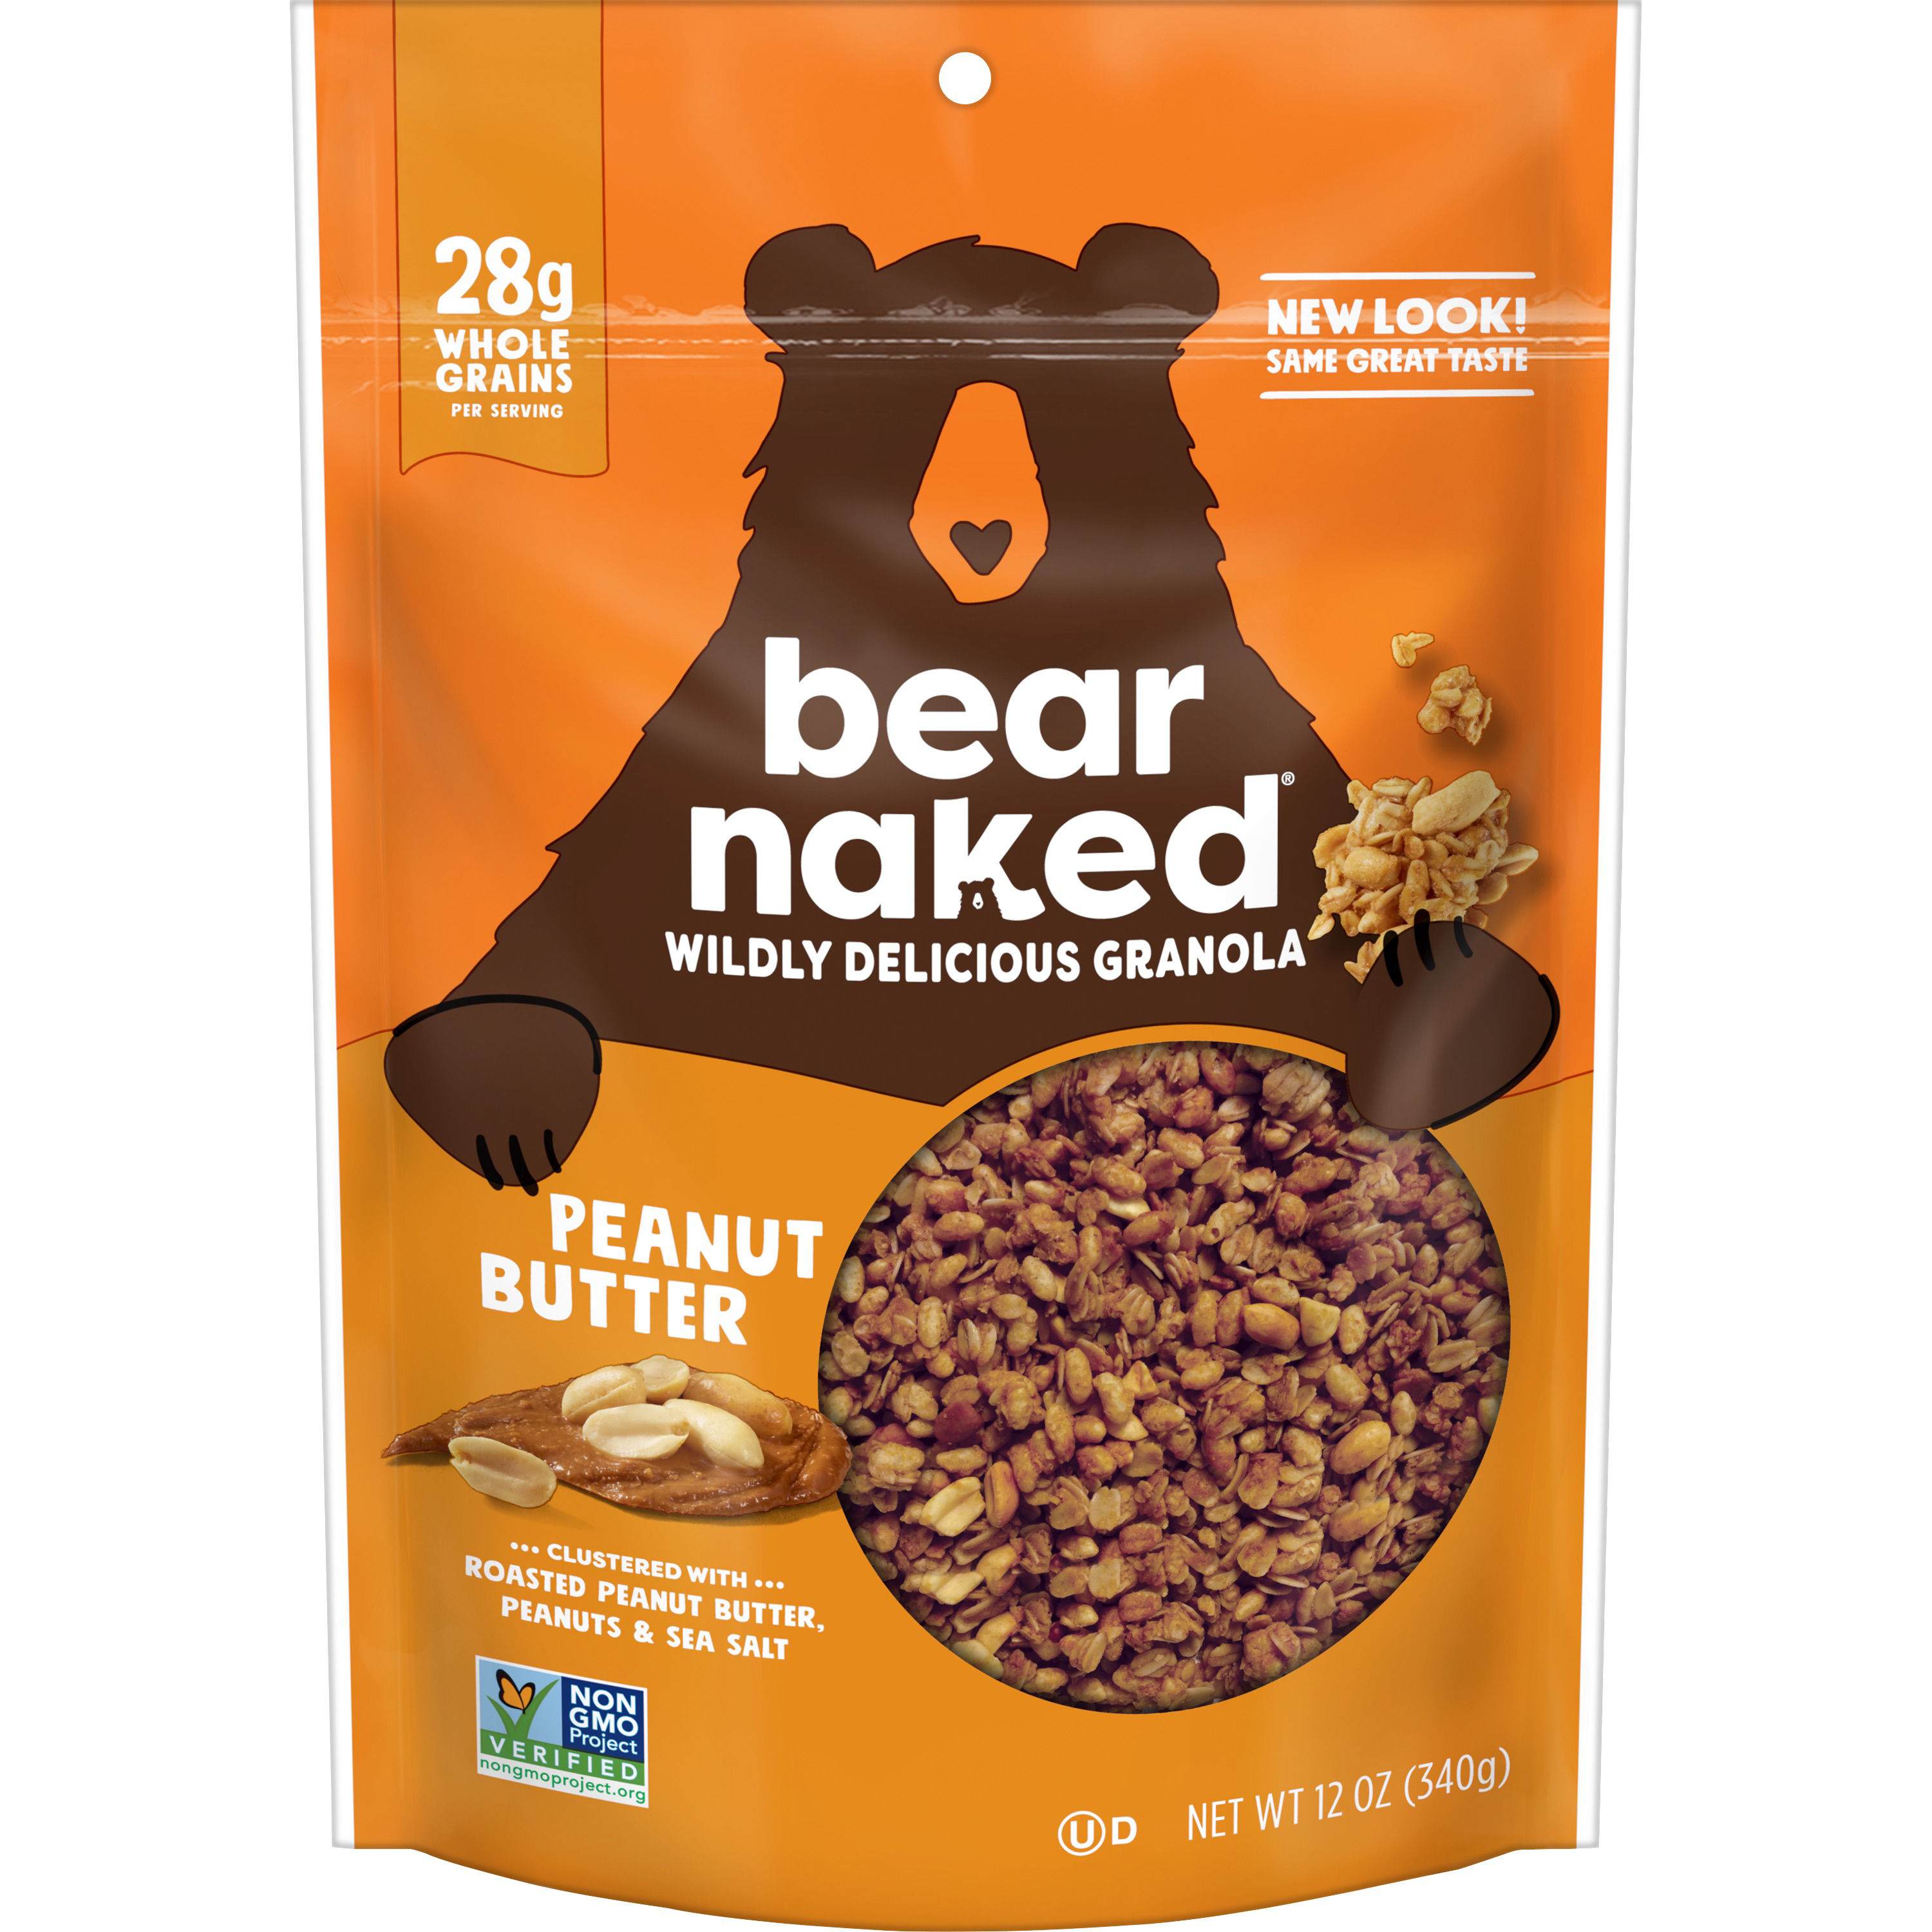
Bear Naked
Archetype: The Explorer
Core desire: To harness adventurous flavor and natural ingredients
Characterized by: non-GMO/whole-grain, outdoor imagery
TogaNolas advantage:

Slide 22
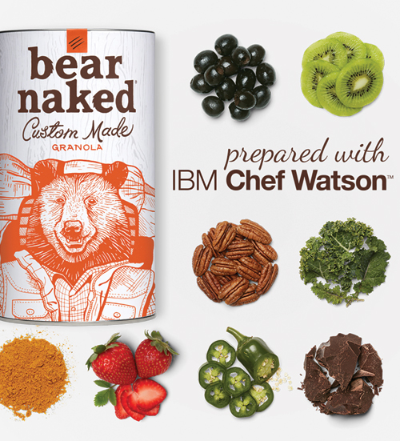
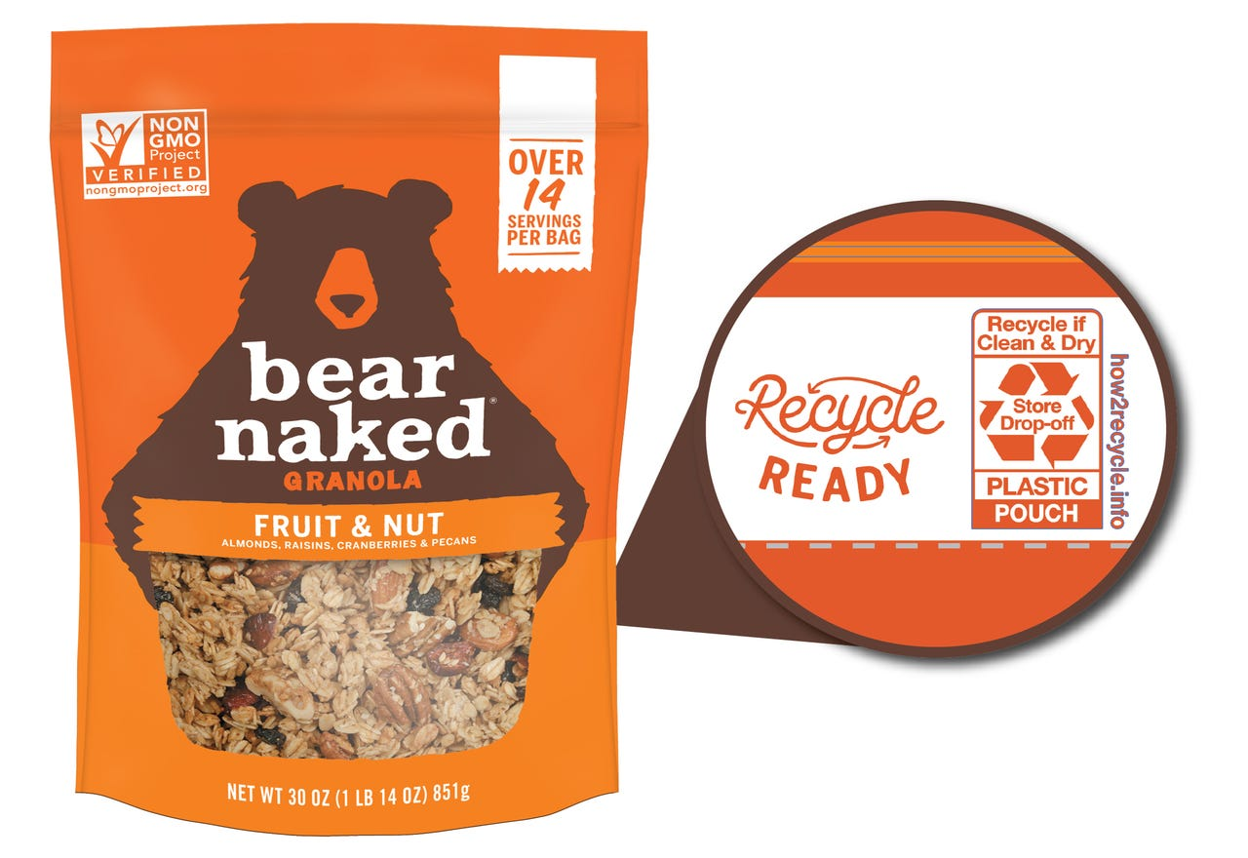

Bear Naked Marketing Content
Innovation story: online experience powered by IBM Chef Watson where consumers could build their own granola blends
Campaign: #OneUpIt — targeted active consumers, by partnering with U.S. Winter Olympic athletes
Packaging/ sustainability story: Introduced fully recyclable flexible packaging (US) in August 2019

Slide 23
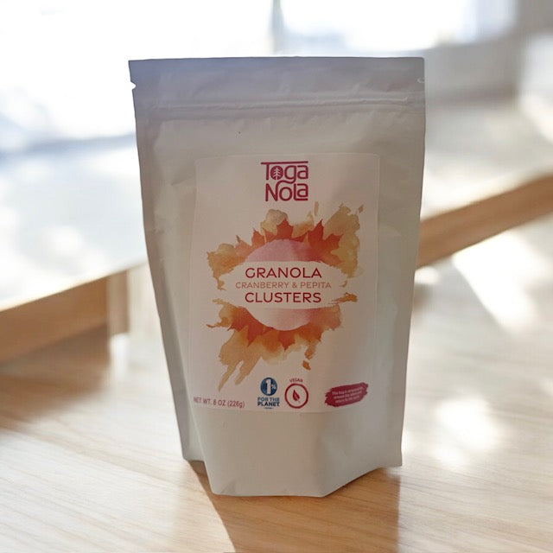
TogaNola’s Key Differentiators
Community Driven: Gives back and supports Saratoga causes
Innovation Flavors: Creative and bold combinations that stand out
Versatile Product Line: Bars, clusters, and protein bombs for any occasion
Sustainable Packaging: Eco-friendly, compostable materials that reduce waste
1% give back

Slide 24
The Challenge

Slide 25
Today’s granola market is crowded with national brands that feel impersonal and overly processed. Consumers want clean, convenient snacks that not only fit an active lifestyle but also have a meaningful impact.

Slide 26
Positioning #1
Community Driven

Slide 27
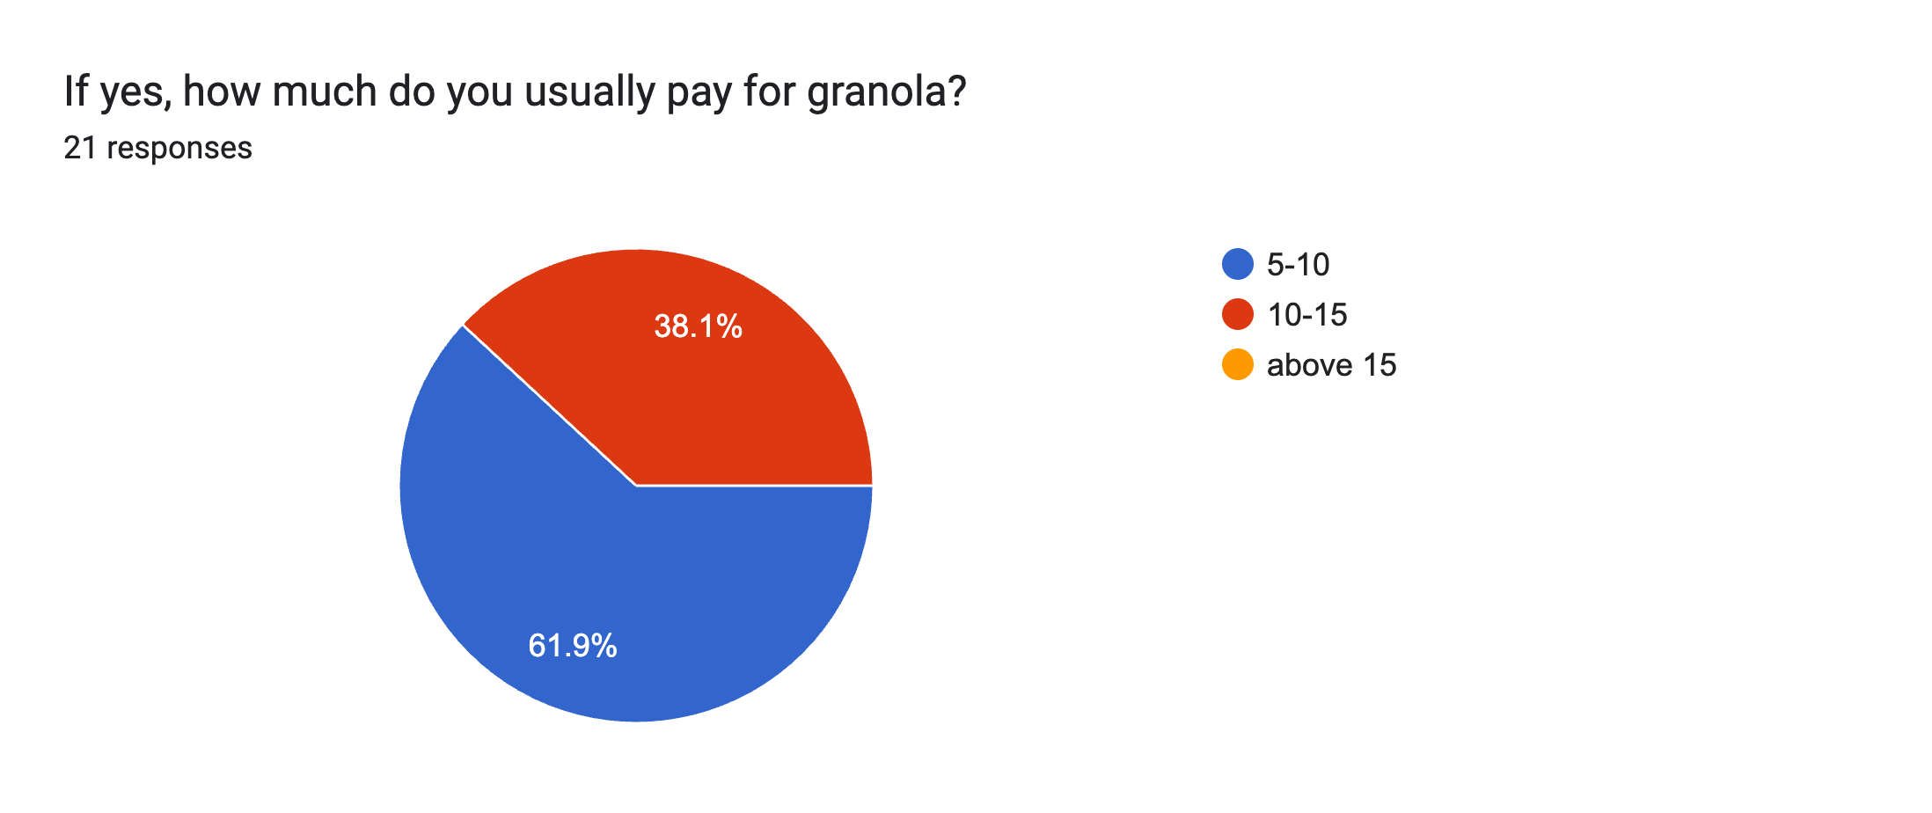
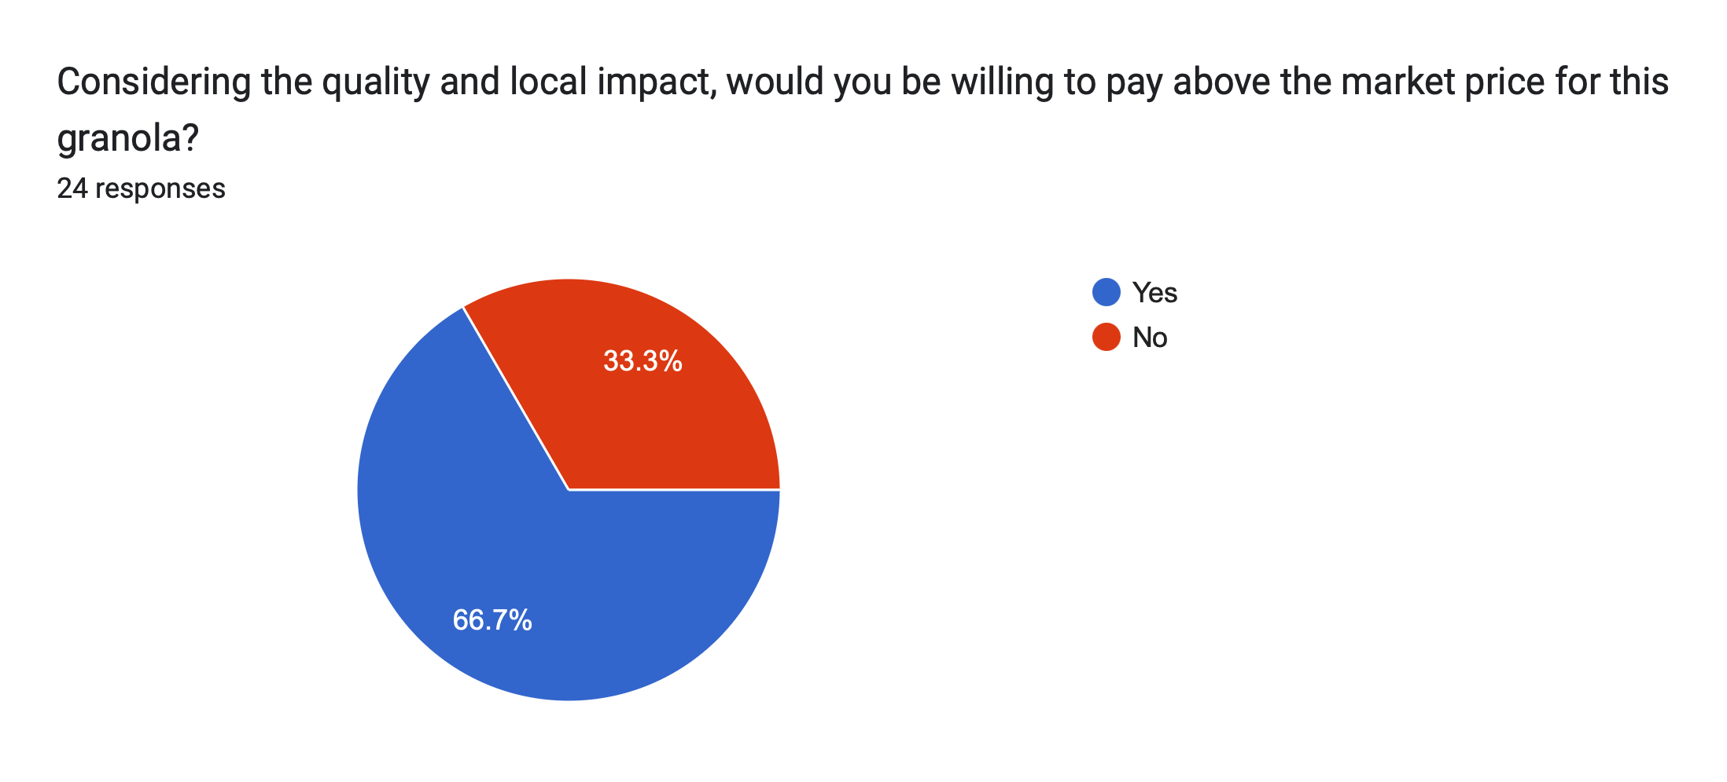

Primary Research findings

Slide 28
Key Message
TogaNola isn’t just made in Saratoga, it’s made for Saratoga. It’s granola that gives back and keeps Saratoga strong.

Slide 29
How TogaNola Differentiates from Competitors
Born from a mission of care: each bite fuels both healthy lifestyles and the Saratoga community.
Uses locally sourced, real ingredients and natural sweeteners like local honey and maple syrup.
Made in Saratoga, for Saratoga: directly supports local causes and nonprofits with every purchase.
Competitors focus on adventure or wellness, but TogaNola links energy to the community.

Slide 30
Why This Will Work
Three out of every four consumers say they reconsider purchase decisions because of the ingredient list.
→ Implication: Using natural, traceable ingredients gives TogaNola a strong positioning.
Every purchase helps support Saratoga Springs charities, schools, and local causes, strengthening community ties.
The gluten-free space is growing rapidly, with higher growth rates (~7-10% CAGR) in recent years.
Small-batch, handcrafted production uses eco-friendly packaging to promote sustainability.
The vegan snack space is much larger (~$47 billion base in 2024) and also growing significantly (~8.5% CAGR).
Notes:
https://www.innovamarketinsights.com/trends/clean-label-food-in-the-us-canada/?utm

Slide 31
Tagline
Snack Local. Give Back. Grow Saratoga.

Slide 32
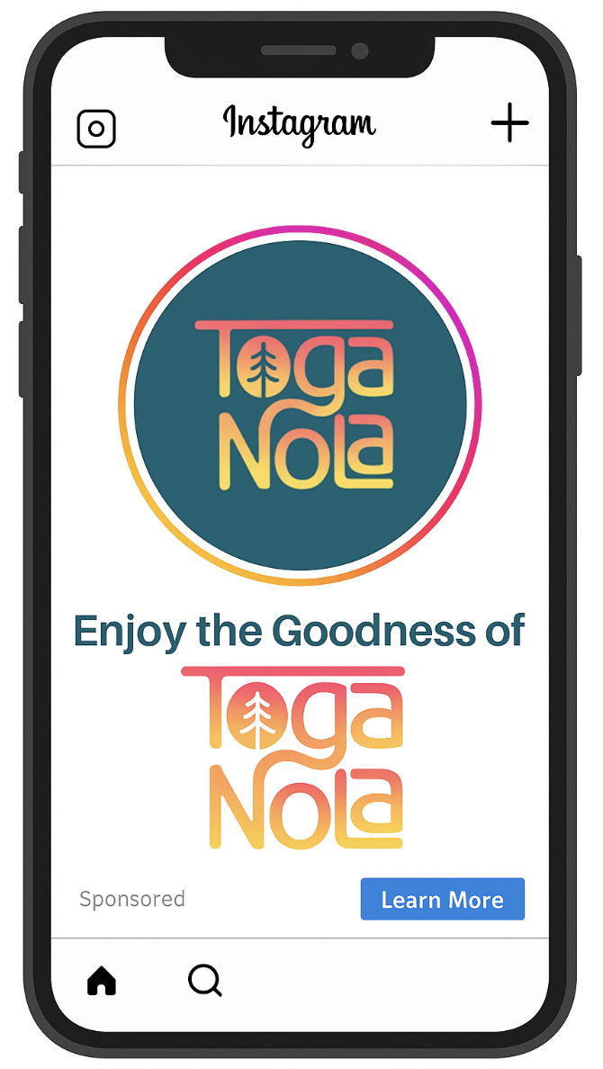


Creative
Instagram ads that promote TogaNola and build your community outreach. Focused on expanding the community.

Slide 33
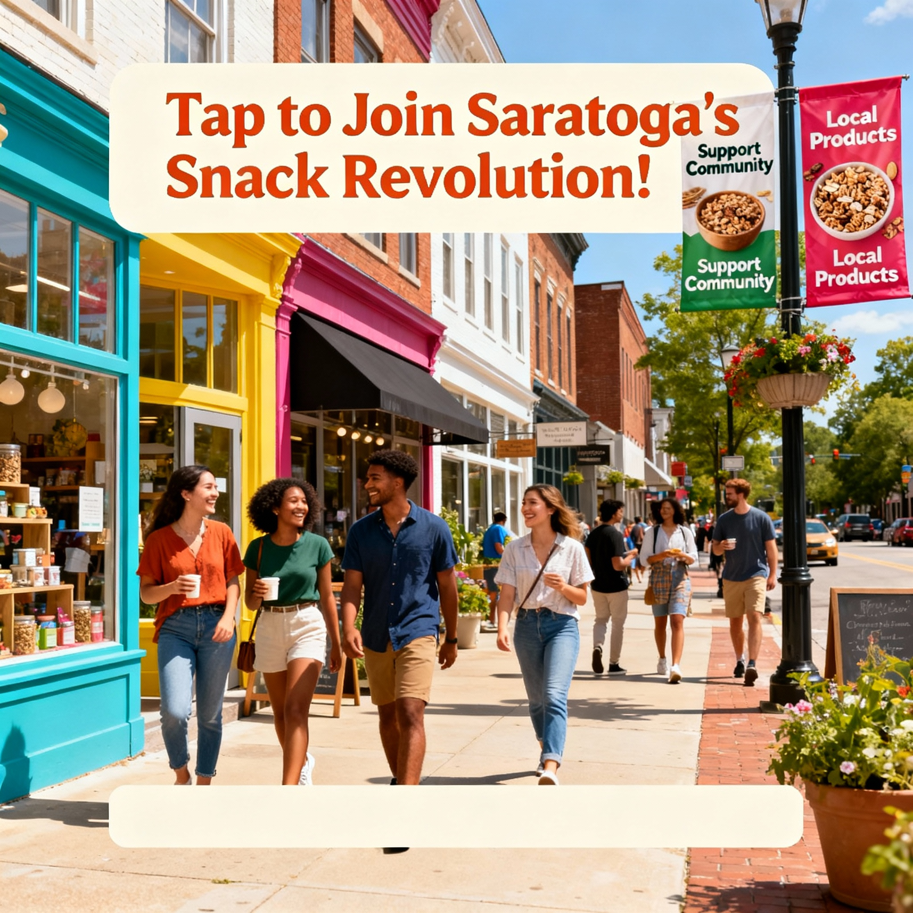
Eat Good, Do Good
Join the #SaratogaSnackHunt and help us keep our community strong!
📍Scan the hidden QR codes around town
🎁 Win free granola + exclusive local experiences
💚 Every purchase supports Saratoga causes
Snack with purpose. Be part of the change.
Tap to learn more & join the hunt! 🔗
#TogaNola #SnackLocalGiveBack #SaratogaStrong #CommunityFirst #GranolaWithPurpose

Slide 34
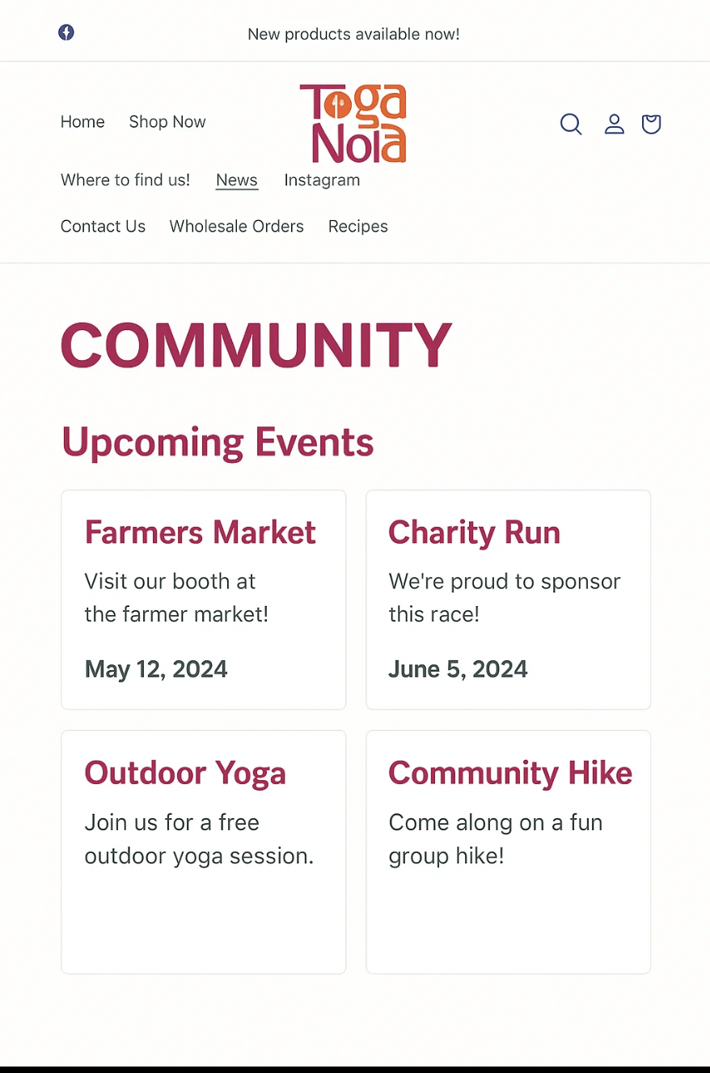

Creative
Community page for the website that details the events and sponsorships TogaNola is a part of

Slide 35
Positioning #2
Active Lifestyle

Slide 36
Key Message
Hero: Granola that powers you to take on the day
TogaNola gives you clean, lasting energy to power you through your day. It’s made for on-the-go lives where you need real fuel that you can trust. Every bite delivers bold flavor, simple ingredients, and the strength to keep moving.

Slide 37

How This Positioning Differentiates from Competitors
Product variety with bars, clusters, and granola bombs
1% for the planet and compostable packaging, which appeals to eco-conscious shoppers balancing health and sustainability
Offers real fuel with flavor, not just another “healthy” snack label.

Slide 38
Why This Will Work
6 in 10 consumers now prefer smaller meals and snacks throughout the day
83.3% of respondents said they would purchase granola because of its convenience
56% of consumers snack daily- Nearly half seek snacks that provide “functional energy or protein”
By combining real fuel + real flavor, TogaNola fills a gap between processed energy bars and bland “health” snacks.
https://www.innovamarketinsights.com/trends/global-snacks-trends-healthy-snacking-innovation/?utm
https://www.grandviewresearch.com/industry-analysis/us-healthy-snacks-market-report

Slide 39
Tagline
"Everyday Energy"

Slide 40


Instagram Ad 1
Caption:
Made for class, work, gym, practice, repeat.
Everyday Energy.
Click the link in bio to purchase.
#TogaNola #SnackWithPurpose

Slide 41

Instagram Ad 2
Caption:
Everyday Energy for the sideline crew ⚽️🥣
Packed by mom, powered by Toga Nola.
Click the link in bio to purchase
#TogaNola #SoccerSnacks #EverydayEnergy
#SaratogaSprings

Slide 42
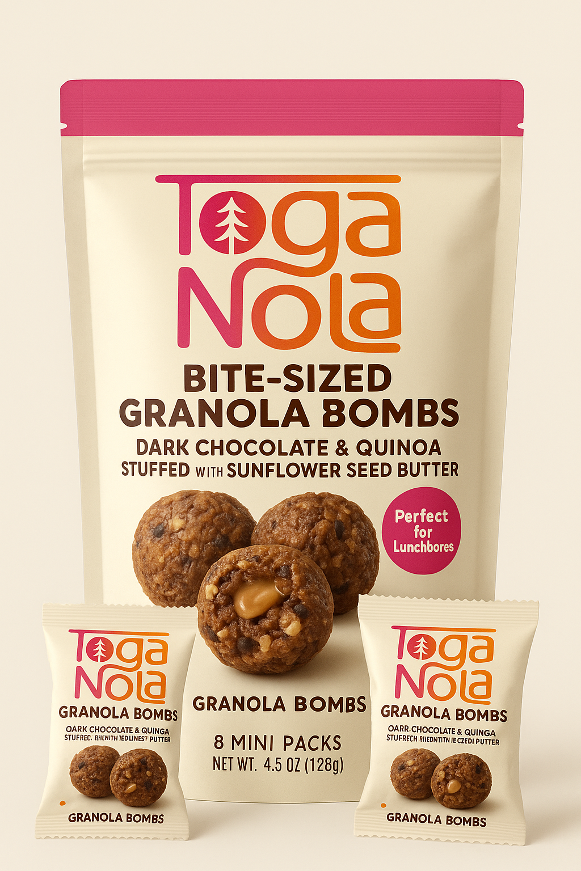
Bite-Sized Granola Bombs
In mini snack packs, to make snacking on the go even easier

Slide 43

Instagram Ad 3
Caption:
New drop 🚨
Meet our Bite-Sized Granola Bombs — dark chocolate & quinoa on the outside, sunflower seed butter on the inside 💥
Perfect for lunchboxes, gym bags, desk drawers, mom purses, all of it.
This is your everyday energy in mini form.
Click the link in bio to purchase.

Slide 44
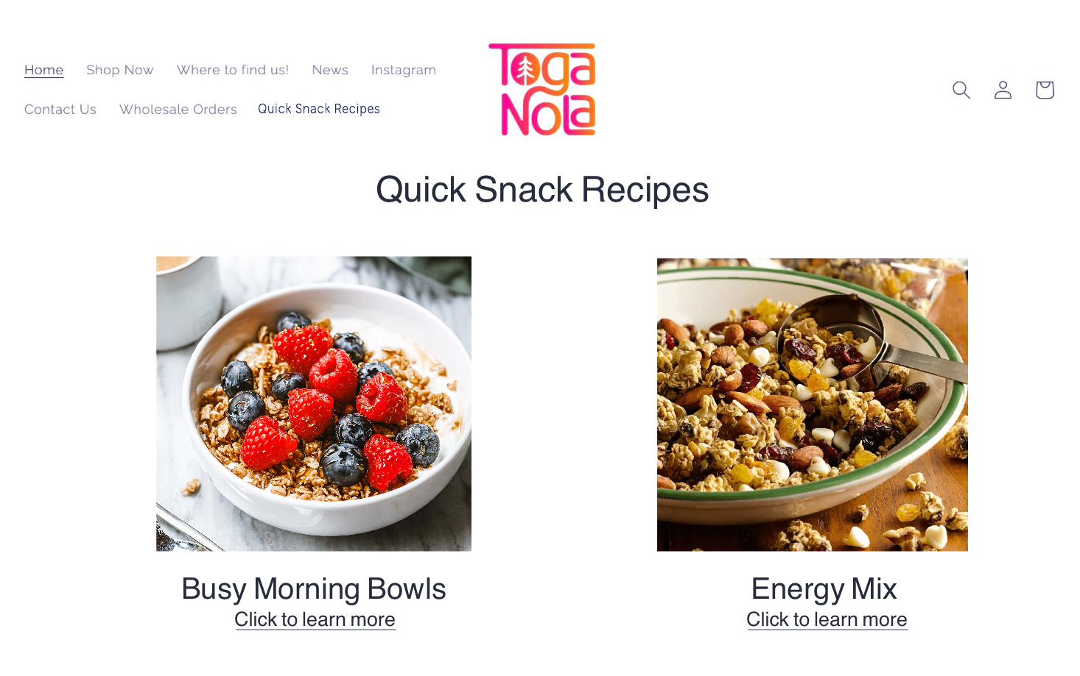
Quick on the go snack recipes featured on the website- quick fuel recipes

Slide 45
Conclusion

Slide 46
Conclusion
The Challenge: Today’s granola market is crowded with national brands that feel impersonal and overly processed.
The Competition: Purely Elizabeth, Dansville Granola, and Bear Naked
Positioning #1: Community Driven, "The Caregiver", promoting taking care of, and being a part of the community as the main value for the company
Positioning #2: Fuels an Active Lifestyle, "the Hero", promoting the easy-to-grab and take-on-the-go aspect for busy individuals looking for clean energy

